Slide 1
  Manager change in MLC’s fixed income strategies
  October 2017
This material is not for circulation to retail investors.

Slide 2
Important information
This information is provided by MLC Investments Limited (ABN 30 002 641 661 AFSL 230705) as Responsible Entity and NULIS Nominees (Australia) Limited (ABN 80 008 515 633, AFSL 236465) as trustee of the MLC MasterKey and Fundamentals Super and Pension and MLC MasterKey Business Super products which are a part of the MLC Super Fund (ABN 70 732 426 024 (together “MLC” or “we”), all members of the National Australia Bank Limited (ABN 12 004 044 4397, AFSL 230 686) group of companies, 105–153 Miller Street, North Sydney 2060. An investment in any product offered by a member company of the National Australia Bank group of companies does not represent a deposit with or a liability of the National Australia Bank Limited (ABN 12 004 044 937) or its subsidiaries.
This presentation has been prepared for licensed financial advisers only. This document must not be distributed to “retail clients” (as defined in the Corporations Act 2001 (Cth)) or any other persons.
This information may constitute general advice. It has been prepared without taking account of an investor’s objectives, financial situation or needs and because of that an investor should, before acting on the advice, consider the appropriateness of the advice having regard to their personal objectives, financial situation and needs.
Investors should obtain a Product Disclosure Statement or other disclosure document relating to any financial product which is issued by MLC, and consider it before making any decision about whether to acquire or continue to hold the product. A copy of the Product Disclosure Statement or other disclosure document is available upon request by phoning the MLC call centre on 132 652 or on our website at mlc.com.au.
Past performance is not a reliable indicator of future performance. The value of an investment may rise or fall with the changes in the market. Any projection or other forward looking statement (‘Projection’) in this document is provided for information purposes only. No representation is made as to the accuracy or reasonableness of any such Projection or that it will be met. Actual events may vary materially.
MLC relies on third parties to provide certain information and are not responsible for its accuracy. MLC is not liable for any loss arising from any person relying on information provided by third parties. While MLC has taken all reasonable care in producing this communication, subsequent changes in circumstances may occur and impact on its accuracy. The investment managers are current as at the date this communication was prepared. Investment managers are regularly reviewed and may be appointed or removed at any time without prior notice to you.
The funds affected by these changes
The following funds are affected by the changes to our fixed income strategies. These funds appear on MLC’s platforms, in addition to a number of external platforms:
MLC Wholesale Horizon 1 Bond Portfolio MLC Horizon 1 Bond Portfolio MySuper
MLC Wholesale Horizon 2 Income Portfolio MLC Horizon 2 Capital Stable Portfolio MLC Horizon 2 Income Portfolio
MLC Wholesale Horizon 3 Conservative Growth Portfolio MLC Horizon 3 Conservative Growth Portfolio
MLC Wholesale Horizon 4 Balanced Portfolio MLC Horizon 4 Balanced Portfolio
MLC Wholesale Horizon 5 Growth Portfolio MLC Horizon 5 Growth Portfolio
MLC Wholesale Diversified Debt Fund MLC Diversified Debt Fund

Slide 3
What’s changed?
We’ve appointed Muzinich & Co Limited (Muzinich) to manage part of our global high yield bonds and loans allocation.
We've removed Oaktree Capital Management, L.P. (Oaktree), our US high yield loans manager since 2005. While Oaktree has been a successful contributor to our funds, we were looking for a broader global strategy.
Muzinich will give us opportunities to invest in high yield loans not only in developed markets (US and Europe), but also emerging markets (Asia, Latin America, Eastern Europe). Muzinich's capabilities extend to high yield bonds.
Which funds are affected?
MLC Diversified Debt Fund
MLC Horizon portfolios 1 to 5, and
MySuper.

Slide 4
Why we’re making these changes
We actively manage our portfolios and evolve them as the investment environment changes and opportunities arise.
We believe the new manager will give us access to a greater diversity of investments and help improve the return potential for our fixed income portfolios.
Muzinich's investment style, credit selection process and investment breadth meet the current needs of our strategies.
Muzinich’s approach will complement our existing managers, Loomis and Shenkman, which currently invest mainly in US high yield loans.
How may clients benefit?
We anticipate improved return potential for our fixed income portfolios without a material change to their risk profile. This is due to greater access to high yield investments across regions and countries.

Slide 5
Why do we invest in global high yield fixed income?
At times when credit risks are appropriately compensated, these investments can offer attractive returns for the risk taken.
Our allocation to this sector is therefore opportunistic and currently focuses on high yield corporate bank loans.

Slide 6
What are global high yield loans and bonds?
Global bank loans
These instruments are a floating interest rate source of funding issued by companies rated below investment grade. They usually pay higher floating rates of interest because they have a higher risk of default. Global bank loans are secured, so are expected to provide better capital protection than high yield bonds, which are typically unsecured.
These loans are particularly attractive in the current environment of low interest rates. Being secured is an important feature as it means the loans are considered ‘senior’ and take priority over unsecured bond investors.
Global high yield bonds
These are fixed rate bonds issued by companies that have a credit rating below investment grade. They usually pay higher fixed rates of interest because they have a higher risk of default and are unsecured.

Slide 7
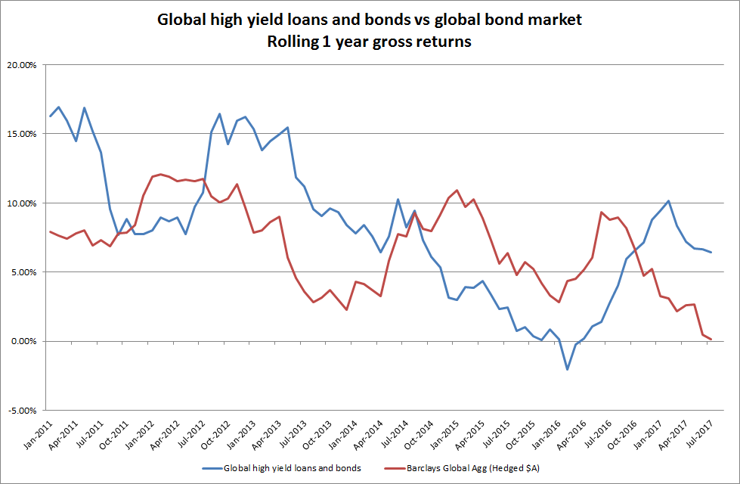
How has global high yield fixed income performed?
In recent years and historically, these assets have at times performed strongly relative to investment grade bonds. Despite the higher risk, the sector plays a return-seeking and diversification role in our strategies.
Source: NAB Asset Management Services Limited. The returns for global high yield loans and bonds are before deducting fees and tax and are hedged to the Australian dollar.
In the current environment of low interest rates, the floating rates of interest provide a premium above government bonds with less interest rate risk.

Slide 8

Who is Muzinich?
The company was founded in New York in 1988 by George Muzinich and is owned by Muzinich family members and their trusts. George Muzinich is the Chairman and CEO and his son, Justin Muzinich, is President.
Muzinich is an experienced manager specialising in credit assets (corporate bonds and bank loans). Muzinich invests across a broad range of high yield sectors in developed and emerging markets.
Muzinich has $44.8 billion of assets under management (at 30 June 2017).
The firm has a track record of constructing well-diversified, liquid high yield bonds and loan portfolios which have produced strong relative performance. Muzinich seeks to tactically allocate across a range of high yield sectors to maximise investment opportunities, while protecting capital. Muzinich has consistently met its performance objective while avoiding material losses.
When choosing securities, Muzinich applies a combination of top-down and bottom-up proprietary credit research.

Slide 9
Are there fee implications?
There’s no impact on fees for the following funds because they have fixed investment fees:
  MLC Wholesale Horizon 1 to 5 and Diversified Debt portfolios in the MLC Investment Trust and MLC MasterKey Unit Trust
  MySuper
There’s a very small reduction on fees for the following funds because they have variable investment fees:
  MLC Horizon 1 to 5 and Diversified Debt portfolios available in MLC MasterKey superannuation and pension platforms
Investment fees are available in the Fund Profile Tool on mlc.com.au and mlcinvestmenttrust.com.au
For further information regarding fees please refer to the product PDS.

Slide 10
What’s the communication plan?
Date | Audience | Communication | Location/medium
Mid October | Advisers | Strategy update presentation | ENGAGE email from NAB AM, MLC News, NAB FP News Wrap and published on mlc.com.au and nabam.nab.com.au
Mid October | Advisers & clients | Economic and market update video and Q&A | ENGAGE email from NAB AM, MLC News, NAB FP News Wrap and published on mlc.com.au, and nabam.nab.com.au
Mid October | Advisers & clients | Commentaries | Commentaries in the Fund Profile Tool will include an overview of changes reflected in the asset allocations dated 30 September
Late October | Advisers | Quarterly investment update (performance pack) | Quarterly performance pack will include an overview of changes. Emailed to advisers in MLC News and published on mlc.com.au
November | Advisers & clients | MySuper quarterly update and portfolio positioning | Video and script on Plum.com.au ‘News and insights’ page

Slide 11
Manager allocations in the global high yield fixed income strategy
Manager | MLC Diversified Debt Fund | MLC Horizon 1 Bond Portfolio | MLC Horizon 2 Capital Stable Portfolio | MLC Horizon 2 Income Portfolio | MLC Horizon 3 Conservative Growth Portfolio | MLC Horizon 4 Balanced Portfolio | MLC Horizon 5 Growth Portfolio | MySuper
 | % (change) | % (change) | % (change) | % (change) | % (change) | % (change) | % (change) | % (change)
Oaktree | 0.00 (-0.75) | 0.00 (-1.05) | 0.00 (-0.23) | 0.00 (-0.45) | 0.00 (-0.23) | 0.00 (-0.30) | 0.00 (-0.30) | 0.00 (-1.20)
Loomis | 1.75 (0.00) | 2.45 (0.00) | 0.53 (0.00) | 1.05 (0.00) | 0.53 (0.00) | 0.70 (0.00) | 0.70 (0.00) | 2.80 (0.00)
Muzinich | 1.00 (1.00) | 1.40 (1.40) | 0.30 (0.30) | 0.60 (0.60) | 0.30 (0.30) | 0.40 (0.40) | 0.40 (0.40) | 1.60 (1.60)
Shenkman Capital | 2.25 (-0.25) | 3.15 (-0.35) | 0.68 (-0.07) | 1.35 (-0.15) | 0.68 (-0.07) | 0.90 (-0.10) | 0.90 (-0.10) | 3.60 (-0.40)
Global high yield fixed income (as % of total portfolio) | 5.00 | 7.00 | 1.50 | 3.00 | 1.50 | 2.00 | 2.00 | 8.00
Note: Figures are rounded to two decimal places and based on target asset allocations.

