Slide 1
Changes to the Australian shares strategy in MLC Horizon and Index Plus
for financial advisers
May 2021
This material is not for circulation to retail investors

Slide 2
Important information
This information has been provided for the funds in the table below by Navigator Australia Limited (ABN 45 006 302 987 AFSL 236466), MLC Investments Limited (ABN 30 002 641 661 AFSL 230705) as Responsible Entity for the MLC Investment Trust, NULIS Nominees (Australia) Limited (ABN 80 008 515 633, AFSL 236465) as trustee of the MLC MasterKey Fundamentals Super and Pension and MLC MasterKey Business Super products which are a part of the MLC Super Fund (ABN 70 732 426 024, members of the National Australia Bank Limited (ABN 12 004 044 937, AFSL 230686) group of companies (NAB Group), 105–153 Miller Street, North Sydney 2060. NAB does not guarantee or otherwise accept any liability in respect of any financial product referred to in this document.
This presentation has been prepared for licensed financial advisers only. This document must not be distributed to “retail clients” (as defined in the Corporations Act 2001 (Cth)) or any other persons. This information is directed to and prepared for Australian residents only.
Some information contained in this presentation may constitute general advice. It has been prepared without taking account of an investor’s objectives, financial situation or needs and because of that an investor should, before acting on the advice, consider the appropriateness of the advice having regard to their personal objectives, financial situation and needs. Investors should obtain a Product Disclosure Statement or other disclosure document relating to any financial product which is issued by MLC and consider it before making any decision about whether to acquire or continue to hold the product. A copy of the Product Disclosure Statement or other disclosure document is available upon request by phoning the MLC call centre on 132 652 or on our website at mlc.com.au.
The value of an investment may rise or fall with the changes in the market. Any projection or other forward-looking statement (‘Projection’) in this document is provided for information purposes only. Whilst reasonably formed, no representation is made as to the accuracy of any such Projection or that it will be met. Actual events may vary materially.
The information in this communication is indicative and prepared for information purposes only and does not purport to contain all matters relevant to any particular investment or financial instrument. Any opinions expressed in this communication constitute our judgement at the time of issue. We believe that the information contained in this communication is correct and that any estimates, opinions, conclusions or recommendations are reasonably held or made at the time of compilation. However, no warranty is made as to their accuracy or reliability. The information in this communication is subject to change without notice, and we shall not be under any duty to update or correct it. All statements as to future matters are not guaranteed to be accurate and any statements as to past performance do not represent future performance. We may rely on third parties to provide certain information. We are not responsible for its accuracy or liable for any loss arising from person relying on information provided by third parties. Subject to any terms implied by law and which cannot be excluded, we shall not be liable for any errors, omissions, defects or misrepresentations in this communication (including by reasons of negligence, negligent misstatement or otherwise) or for any loss or damage (whether direct or indirect) suffered by persons who use or rely on the communication.
While MLC has taken all reasonable care in producing this communication, subsequent changes in circumstances may occur and impact on its accuracy. The investment managers are current as at the date this communication was prepared. Investment managers are regularly reviewed and may be appointed or removed at any time without prior notice to you.
The following funds are affected by the changes to MLC’s Australian shares strategy. These funds appear on MLC’s platforms and external platforms:
MLC Horizon 2 Capital Stable Portfolio MLC Wholesale Horizon 2 Income Portfolio MLC Pre Select Conservative Fund
MLC Horizon 2 Income Portfolio MLC Wholesale Horizon 3 Conservative Growth Portfolio MLC Pre Select Balanced Fund
MLC Horizon 3 Conservative Growth Portfolio MLC Wholesale Horizon 4 Balanced Portfolio MLC Pre Select Growth Fund
MLC Horizon 4 Balanced Portfolio MLC Wholesale Horizon 5 Growth Portfolio MLC Pre Select High Growth Fund
MLC Horizon 5 Growth Portfolio MLC Wholesale Horizon 6 Share Portfolio MLC Index Plus Conservative Growth Portfolio
MLC Horizon 6 Share Portfolio MLC Wholesale Horizon 7 Accelerated Growth Portfolio MLC Index Plus Balanced Portfolio
MLC Horizon 7 Accelerated Growth Portfolio MLC Wholesale Index Plus Conservative Growth Portfolio MLC Index Plus Growth Portfolio
MLC Wholesale Index Plus Balanced Portfolio MLC Wholesale Index Plus Growth Portfolio
Changes to the Australian shares strategy in MLC Horizon and Index Plus, for financial advisers

Slide 3
What’s changed and why?
What’s changed?
Why?
Appointed Macquarie Investment Management as an ‘enhanced index’ Australian shares manager, and removed Redpoint
BlackRock remains as our other enhanced index manager
Funds affected are:
MLC Index Plus portfolios
MLC Horizon 2 to 7 portfolios, and
MLC Pre Select funds
There’s no impact on fees as a result of these changes
Our Australian shares enhanced index managers provide our multi-asset portfolios with exposure to Australian shares while generating a small amount of outperformance (of the S&P/ASX 200 Total Return Index), at a low cost, and with low tracking error (risk)
We have greater confidence in Macquarie’s ability to outperform the market more consistently, through a range of different market conditions, and controlling risk
While Macquarie and BlackRock are both quantitative managers, their investment processes are sufficiently different to provide risk and return diversification
Redpoint continues to manage passive global shares and REITs strategies in our Index Plus portfolios
Client benefit
We believe this change will improve return consistency for clients over the medium term
Changes to the Australian shares strategy in MLC Horizon and Index Plus, for financial advisers

Slide 4
Profile of Macquarie
About Macquarie
Why we’ve appointed Macquarie
Macquarie’s systematic capability manages ~$27 billion
We believe Macquarie’s appointment improves the likelihood of the enhanced index component of the Australian shares strategy delivering more consistent outperformance while meeting the risk constraints of the strategy
Macquarie has demonstrated a good track record through various market conditions, driven by strong research and portfolio construction
Macquarie’s investment process complements BlackRock’s as their research processes, and their risk and alpha generating insights, are sufficiently different
Meets our requirements for a low-cost solution
Other strengths of Macquarie’s systemic equities team include:
Blends different skills of investment team members, combining market knowledge and disciplined research
Has a risk-controlled framework
Modelling and research that considers the unique composition and behaviour of the Australian share market
Has proprietary databases and systems
Constantly researches and implements new investment signal ideas, ensuring their process is constantly evolving
Is tax aware and has efficient implementation of transactions
Macquarie’s systemic equities team are a high quality, quantitative investment manager with strong research credentials. It comprises 5 key team members who average ~20 years’ investment experience. Their systemic capability has been operating for ~25 years
Macquarie’s style neutral portfolio tilts stock exposures based on a consistent, research-led, quantitative investment process, and uses qualitative judgements when markets become volatile and dislocated
Macquarie uses quantitative techniques to score stocks capturing:
Quality - identifies companies with strong business models exhibiting good profitability, stability and sustainability
Sentiment - identifies trending behaviour in stocks that is likely to continue
Value - employs a systematic screen of companies across multiple dimensions such as industry, quality, profitability, growth, risk, and size
A portfolio manager links the stock scoring models to current market conditions, recognising there are situations or events that may not be captured using a purely systematic process
Changes to the Australian shares strategy in MLC Horizon and Index Plus, for financial advisers

Slide 5
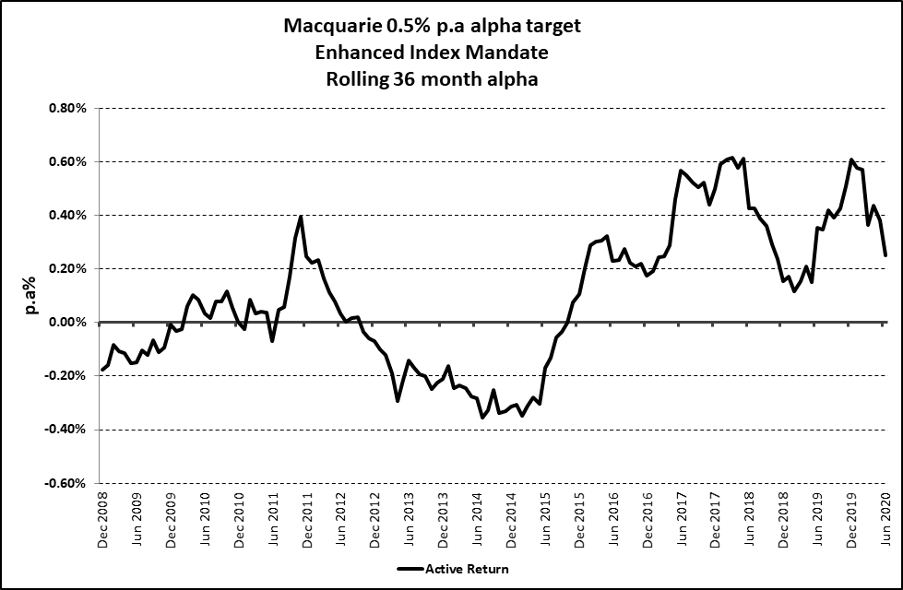
Macquarie’s consistent performance
The graph shows Macquarie’s enhanced index investment process has successfully produced incremental alpha, with consistency
Macquarie’s low risk, low alpha strategy is expected to complement BlackRock’s
The Macquarie “0.5% alpha target” product’s performance has the same investment process as the lower risk and lower alpha version we’ve appointed Macquarie to manage. The lower risk, lower alpha product doesn’t have a performance history.
Source: MLC Asset Management Services Limited. Returns are before the deduction of fees (as fees are not deducted at the manager level). Past performance is not indicative of future performance.
Changes to the Australian shares strategy in MLC Horizon and Index Plus, for financial advisers

Slide 6
New manager line-up
Australian shares managers | Horizon |  | Index Plus
 | Updated | (Change) | Updated | (Change)
Alphinity | 17%
Antares | 20%
Northcape | 14%
Vinva | 19%
BlackRock | 15% |  | 50%
Redpoint |  | (-15%) |  | (-50%)
Macquarie | 15% | (+15%) | 50% | (+50%)
Total | 100% |  | 100%
Pre Select’s manager mix is the same as MLC Horizon
Changes to the Australian shares strategy in MLC Horizon and Index Plus, for financial advisers

Slide 7
Communication plan
When | Who | What | Where
Mid to late May | Advisers | This presentation outlining the changes | Included in Adviser Bulletin email to advisers Published in adviser sections of mlc.com.au and mlcam.com.au (in ‘Strategy updates’ section) Included in MLC News email to advisers and published on MyNews
Late July | Advisers | Investment update for financial advisers – July 2021 | Included in Adviser Bulletin email to advisers Published on mlc.com.au (in Fund Commentaries, under Prices and Performance accessed from Adviser tab) and mlcam.com.au (under ‘Latest quarterly reporting resources’ in ‘Adviser only’ section)
Late July | Advisers and clients | Fund commentaries | mlc.com.au/fundprofiletool mlcam.com.au/MLCWholesale, select Fund Profile Tool
Changes to the Australian shares strategy in MLC Horizon and Index Plus, for financial advisers

