Slide 1
Changes to the fixed income strategy in MLC Horizon and Index Plus
for financial advisers
May 2021
This material is not for circulation to retail investors

Slide 2
Important information
This information has been provided for the funds in the table below by Navigator Australia Limited (ABN 45 006 302 987 AFSL 236466), MLC Investments Limited (ABN 30 002 641 661 AFSL 230705) as Responsible Entity for the MLC Investment Trust, NULIS Nominees (Australia) Limited (ABN 80 008 515 633, AFSL 236465) as trustee of the MLC MasterKey Fundamentals Super and Pension and MLC MasterKey Business Super products which are a part of the MLC Super Fund (ABN 70 732 426 024, members of the National Australia Bank Limited (ABN 12 004 044 937, AFSL 230686) group of companies (NAB Group), 105–153 Miller Street, North Sydney 2060. NAB does not guarantee or otherwise accept any liability in respect of any financial product referred to in this document.
This presentation has been prepared for licensed financial advisers only. This document must not be distributed to “retail clients” (as defined in the Corporations Act 2001 (Cth)) or any other persons. This information is directed to and prepared for Australian residents only.
Some information contained in this presentation may constitute general advice. It has been prepared without taking account of an investor’s objectives, financial situation or needs and because of that an investor should, before acting on the advice, consider the appropriateness of the advice having regard to their personal objectives, financial situation and needs. Investors should obtain a Product Disclosure Statement or other disclosure document relating to any financial product which is issued by MLC and consider it before making any decision about whether to acquire or continue to hold the product. A copy of the Product Disclosure Statement or other disclosure document is available upon request by phoning the MLC call centre on 132 652 or on our website at mlc.com.au.
The value of an investment may rise or fall with the changes in the market. Any projection or other forward-looking statement (‘Projection’) in this document is provided for information purposes only. Whilst reasonably formed, no representation is made as to the accuracy of any such Projection or that it will be met. Actual events may vary materially.
The information in this communication is indicative and prepared for information purposes only and does not purport to contain all matters relevant to any particular investment or financial instrument. Any opinions expressed in this communication constitute our judgement at the time of issue. We believe that the information contained in this communication is correct and that any estimates, opinions, conclusions or recommendations are reasonably held or made at the time of compilation. However, no warranty is made as to their accuracy or reliability. The information in this communication is subject to change without notice, and we shall not be under any duty to update or correct it. All statements as to future matters are not guaranteed to be accurate and any statements as to past performance do not represent future performance. We may rely on third parties to provide certain information. We are not responsible for its accuracy or liable for any loss arising from person relying on information provided by third parties. Subject to any terms implied by law and which cannot be excluded, we shall not be liable for any errors, omissions, defects or misrepresentations in this communication (including by reasons of negligence, negligent misstatement or otherwise) or for any loss or damage (whether direct or indirect) suffered by persons who use or rely on the communication.
While MLC has taken all reasonable care in producing this communication, subsequent changes in circumstances may occur and impact on its accuracy. The investment managers are current as at the date this communication was prepared. Investment managers are regularly reviewed and may be appointed or removed at any time without prior notice to you.
The following funds are affected by the changes to MLC’s fixed income strategy. These funds appear on MLC’s platforms, in addition to a number of external platforms:
MLC Horizon 1 Bond Portfolio MLC Wholesale Horizon 1 Bond Portfolio MLC Pre Select Conservative Fund
MLC Horizon 2 Capital Stable Portfolio MLC Wholesale Horizon 2 Income Portfolio MLC Pre Select Balanced Fund
MLC Horizon 2 Income Portfolio MLC Wholesale Horizon 3 Conservative Growth Portfolio MLC Pre Select Growth Fund
MLC Horizon 3 Conservative Growth Portfolio MLC Wholesale Horizon 4 Balanced Portfolio
MLC Horizon 4 Balanced Portfolio MLC Wholesale Index Plus Conservative Growth Portfolio
MLC Index Plus Conservative Growth Portfolio MLC Wholesale Index Plus Balanced Portfolio
MLC Index Plus Balanced Portfolio MLC Wholesale Index Plus Growth Portfolio
MLC Index Plus Growth Portfolio
Changes to the fixed income strategy in MLC Horizon and Index Plus, for financial advisers

Slide 3
What’s changed and why?
What’s changed?
Why?
Appointed Ardea Investment Management as a global absolute return manager, and removed BNP Paribas and Insight
Funds affected are:
MLC Index Plus portfolios
MLC Horizon 1 to 4 portfolios, and
MLC Pre Select funds
There’s no impact on fees as a result of these changes
Global absolute returns is a medium risk, highly liquid, fixed income sector that aims to provide returns that are different from traditional fixed income sectors
We have greater confidence in Ardea’s ability to consistently outperform the cash plus objective of our global absolute return bonds strategy
BNP Paribas and Insight haven’t achieved the cash plus return objectives of their global absolute return bonds mandates, and we lack confidence in their future success
Ardea has demonstrated ability at outperforming a cash plus objective
We continue to have conviction in Insight’s global government bond mandate they’ve managed for us since 2018. Their concentration of bets in the global absolute return bonds strategy wasn’t consistent with our expectations or requirements for that mandate
Client benefit
We believe the changes will provide clients with more consistent outperformance potential, than the previous manager mix
Changes to the fixed income strategy in MLC Horizon and Index Plus, for financial advisers

Slide 4
Profile of Ardea
About Ardea
Why we’ve appointed Ardea
Established in 2008 and based in Sydney
Manages $19 billion (at 31 December 2020)
A key attraction of the Ardea Pure Alpha strategy is the focus on ‘micro relative value strategies’ within developed market government bonds and associated interest rate derivatives. Where other micro relative value managers focus on pure arbitrage relationships such as 10 year bond futures vs 10 year government bonds, Ardea looks for pricing discrepancies just outside the underlying futures basket of bonds. So instead of targeting 10 year government bonds, Ardea may buy 9 and 11 year bonds while shorting the futures. Duration is neutral, they earn the interest rate carry, and wait for the futures prices to converge with the physical bonds. This allows them to target many market anomalies at once
Another attractive feature is the focus on ‘risk balance’ and preserving the defensive characteristics usually desired from fixed income. This is achieved by using options (predominantly buying options), so the strategy is effectively always long volatility, and should perform well in ‘risk-off’ scenarios
The strategy offers daily liquidity, is invested in highly liquid instruments (minimum of 75% held in mostly Australian government bonds), and has demonstrated the ability to stay liquid through the extreme illiquidity squeeze in Mar/Apr 2020
Ardea is a manager in the MLC Premium Model Portfolios. These portfolios invest in the Ardea Real Outcome Fund
Majority of the business is owned by employees
Ardea uses a ‘relative value’ approach which specifically identifies whether a bond is mispriced relative to other related securities with similar risk characteristics and therefore has potential for its price to rise or fall
The Ardea Pure Alpha strategy we’re investing in, has a track record of delivering returns exceeding cash. As these returns are independent of interest rate direction, Ardea is expected to maintain a level of outperformance in rising and falling markets irrespective of the level of the cash rate
Changes to the fixed income strategy in MLC Horizon and Index Plus, for financial advisers

Slide 5
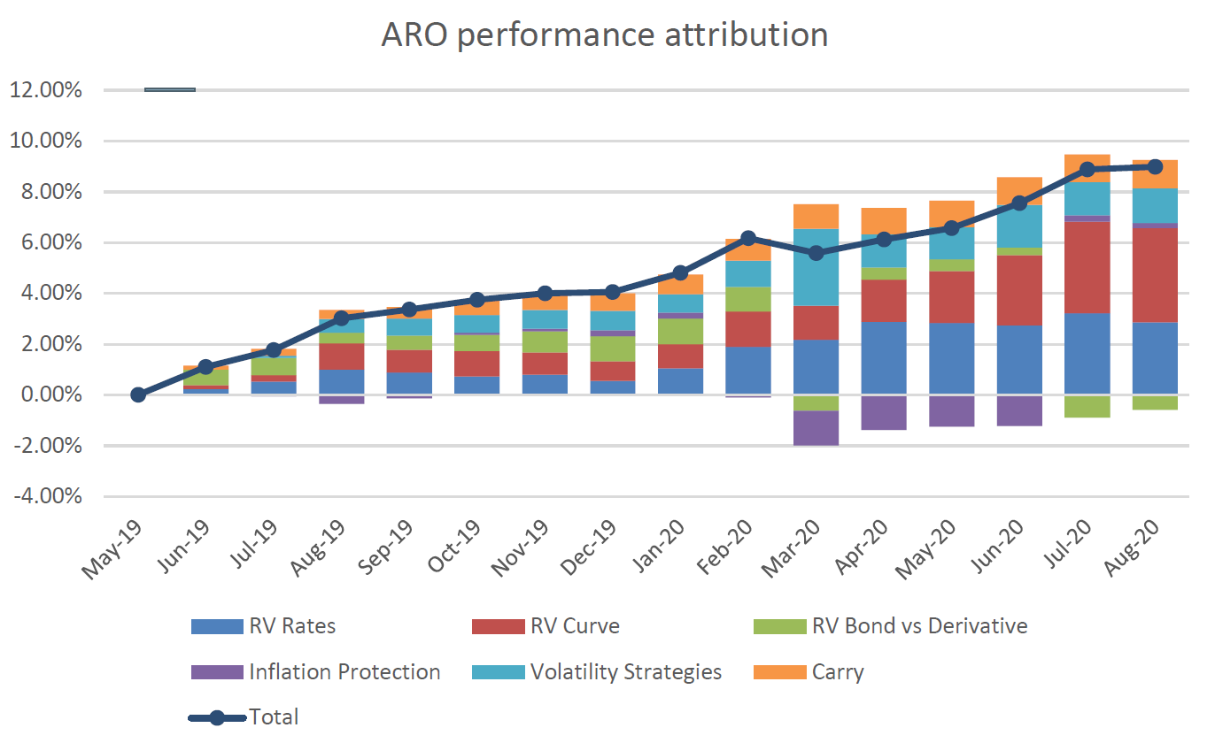
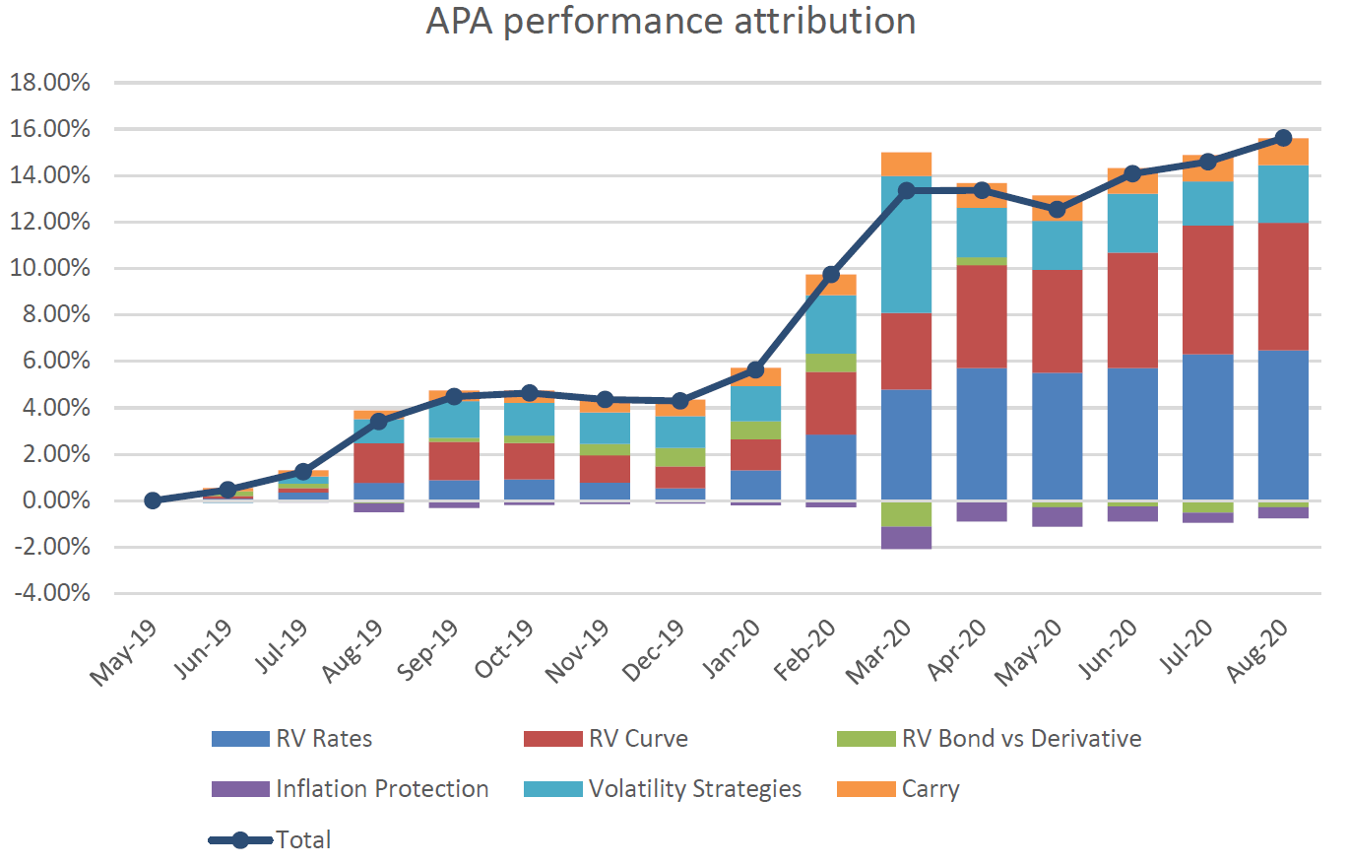
How Ardea’s Real Outcome strategy compares to Ardea’s Pure Alpha strategy
Ardea’s Real Outcome (ARO) strategy, which we’ve used in the MLC Premium Model Portfolios (MLC Managed Account Strategies) since their inception, has a well-established track record through different market environments. ARO has consistently met its cash plus return objective, within expected volatility ranges, since 2012
The Ardea Pure Alpha (APA) strategy, which we’re now using in MLC Horizon and Index Plus portfolios, is a higher return seeking and higher volatility version of the ARO strategy. APA was established in 2019 and has a more limited track record but has demonstrated consistency with ARO, as shown in the performance attribution charts (below) since APA’s inception
Source: MLC Asset Management Services Limited. Returns are before the deduction of fees (as fees are not deducted at the manager level).
Changes to the fixed income strategy in MLC Horizon and Index Plus, for financial advisers

Slide 6
New strategic asset allocations MLC Wholesale
Fixed income sectors | Horizon 1 |  | Horizon 2 |  | Horizon 3 |  | Horizon 4 |  | Index Plus Cons Gwth |  | Index Plus Balanced |  | Index Plus Growth
 | Updated | (Change) | Updated | (Change) | Updated | (Change) | Updated | (Change) | Updated | (Change) | Updated | (Change) | Updated | (Change)
Global absolute return bonds | 2.8% |  | 1.5% |  | 1.0% |  | 0.2% |  | 1.1% |  | 0.3% |  | 0.2%
- BNP |  | (-1.5%) |  | (-0.8%) |  | (-0.6%) |  | (-0.1%) |  | (-0.6%) |  | (-0.2%) |  | (-0.1%)
- Insight |  | (-1.3%) |  | (-0.7%) |  | (-0.4%) |  | (-0.1%) |  | (-0.5%) |  | (-0.1%) |  | (-0.1%)
- Ardea | 2.8% | (+2.8%) | 1.5% | (+1.5%) | 1.0% | (+1.0%) | 0.2% | (+0.2%) | 1.1% | (+1.1%) | 0.3% | (+0.3%) | 0.2% | (+0.2%)
Global government bonds | 4.4% |  | 2.9% |  | 2.2% |  | 1.2% |  | 2.6% |  | 1.5% |  | 0.6%
Global credit | 14.8% |  | 9.0% |  | 6.8% |  | 2.8% |  | 7.7% |  | 3.8% |  | 1.7%
Global multi-sector bonds |  |  | 1.7% |  | 2.0% |  | 2.7% |  | 2.6% |  | 3.0% |  | 1.2%
Global high yield bonds and loans | 7.5% |  | 2.0% |  | 2.0% |  | 2.0%
Securitized debt | 7.5%
Australian bonds | 33.0% |  | 20.9% |  | 16.0% |  | 7.6% |  | 18.5% |  | 9.9% |  | 4.3%
Australian credit | 15.0%
Australian inflation-linked bonds |  |  | 12.5% |  | 11.0% |  | 8.0% |  | 7.5% |  | 6.0% |  | 3.0%
Enhanced cash | 15.0% |  | 10.0% |  | 3.0% |  | 2.0% |  | 8.5% |  | 4.0% |  | 2.5%
Total fixed income | 100.0% |  | 60.5% |  | 44.0% |  | 26.5% |  | 48.5% |  | 28.5% |  | 13.5%
The same manager mix applies to Pre Select, MLC Super and Pension Fundamentals and Business Super
Changes to the fixed income strategy in MLC Horizon and Index Plus, for financial advisers

Slide 7
Communication plan
When | Who | What | Where
Mid to late May | Advisers | This presentation outlining the changes | Included in Adviser Bulletin email to advisers Published in adviser sections of mlc.com.au and mlcam.com.au (in ‘Strategy updates’ section) Included in MLC News email to advisers and published on MyNews
Late July | Advisers | Investment update for financial advisers – July 2021 | Included in Adviser Bulletin email to advisers Published on mlc.com.au (in Fund Commentaries, under Prices and Performance accessed from Adviser tab) and mlcam.com.au (under ‘Latest quarterly reporting resources’ in ‘Adviser only’ section)
Late July | Advisers and clients | Fund commentaries | mlc.com.au/fundprofiletool mlcam.com.au/MLCWholesale, select Fund Profile Tool
Changes to the fixed income strategy in MLC Horizon and Index Plus, for financial advisers

