Slide 1
Changes to MLC’s fixed income strategies and Diversified Debt Fund
for financial advisers
May 2022
This material is not for circulation to retail investors

Slide 2
Important information
This information has been provided for the funds in the table below by Navigator Australia Limited (ABN 45 006 302 987 AFSL 236466), MLC Investments Limited (ABN 30 002 641 661 AFSL 230705) as Responsible Entity for the MLC Investment Trust, NULIS Nominees (Australia) Limited (ABN 80 008 515 633, AFSL 236465) as trustee of the MLC MasterKey Fundamentals Super and Pension and MLC MasterKey Business Super products which are a part of the MLC Super Fund (ABN 70 732 426 024), part of the Insignia Financial Group of companies (comprising Insignia Financial Ltd ABN 49 100 103 722 and its related bodies corporate) (‘Insignia Financial Group’). The capital value, payment of income, and performance of the Funds are not guaranteed. An investment in the Funds is subject to investment risk, including possible delays in repayment of capital and loss of income and principal invested. No member of the Insignia Financial Group guarantees or otherwise accepts any liability in respect of any financial product referred to in this communication.
This presentation has been prepared for licensed financial advisers only. This document must not be distributed to “retail clients” (as defined in the Corporations Act 2001 (Cth)) or any other persons. This information is directed to and prepared for Australian residents only.
Some information contained in this presentation may constitute general advice. It has been prepared without taking account of an investor’s objectives, financial situation or needs and because of that an investor should, before acting on the advice, consider the appropriateness of the advice having regard to their personal objectives, financial situation and needs. Investors should obtain a Product Disclosure Statement or other disclosure document relating to any financial product which is issued by MLC and consider it before making any decision about whether to acquire or continue to hold the product. A copy of the Product Disclosure Statement or other disclosure document is available upon request by phoning the MLC call centre on 132 652 or on our website at mlc.com.au.
Past performance is not a reliable indicator of future performance. The value of an investment may rise or fall with the changes in the market. Any projection or other forward-looking statement (‘Projection’) in this document is provided for information purposes only. Whilst reasonably formed, no representation is made as to the accuracy of any such Projection or that it will be met. Actual events may vary materially.
The information in this communication is indicative and prepared for information purposes only and does not purport to contain all matters relevant to any particular investment or financial instrument. Any opinions expressed in this communication constitute our judgement at the time of issue. We believe that the information contained in this communication is correct and that any estimates, opinions, conclusions or recommendations are reasonably held or made at the time of compilation. However, no warranty is made as to their accuracy or reliability. The information in this communication is subject to change without notice, and we shall not be under any duty to update or correct it. All statements as to future matters are not guaranteed to be accurate and any statements as to past performance do not represent future performance. We may rely on third parties to provide certain information. We are not responsible for its accuracy or liable for any loss arising from person relying on information provided by third parties. Subject to any terms implied by law and which cannot be excluded, we shall not be liable for any errors, omissions, defects or misrepresentations in this communication (including by reasons of negligence, negligent misstatement or otherwise) or for any loss or damage (whether direct or indirect) suffered by persons who use or rely on the communication.
While MLC has taken all reasonable care in producing this communication, subsequent changes in circumstances may occur and impact on its accuracy. The investment managers are current as at the date this communication was prepared. Investment managers are regularly reviewed and may be appointed or removed at any time without prior notice to you.
The following funds are affected by the changes to MLC’s fixed income strategy. These funds appear on MLC’s platforms, in addition to a number of external platforms:
MLC Horizon 2 Capital Stable Portfolio MLC Wholesale Horizon 2 Income Portfolio MLC Pre Select Conservative Fund
MLC Horizon 2 Income Portfolio MLC Wholesale Horizon 3 Conservative Growth Portfolio MLC Pre Select Balanced Fund
MLC Horizon 3 Conservative Growth Portfolio MLC Wholesale Horizon 4 Balanced Portfolio MLC Pre Select Growth Fund
MLC Horizon 4 Balanced Portfolio MLC Wholesale Horizon 5 Growth Portfolio MLC Diversified Debt Fund
MLC Horizon 5 Growth Portfolio MLC Wholesale Index Plus Conservative Growth Portfolio MLC Wholesale Diversified Debt Fund
MLC Index Plus Conservative Growth Portfolio MLC Wholesale Index Plus Balanced Portfolio
MLC Index Plus Balanced Portfolio MLC Wholesale Index Plus Growth Portfolio
MLC Index Plus Growth Portfolio
Changes to MLC’s fixed income strategies and Diversified Debt Fund, for financial advisers

Slide 3
What’s changed and why?
What’s changed?
Why?
Appointed Ardea Investment Management and Janus Henderson Investors as Australian bond managers in the all maturities strategy, and removed UBS Asset Management
Appointed Brandywine Global Investment Management and PGIM Fixed Income as global bond managers in the all maturities strategy, and removed Amundi Asset Management, Insight Investment Management, Loomis Sayles and Wellington Management.
Funds affected are:
MLC Diversified Debt Fund
MLC Horizon 2 to 5
MLC Index Plus
Pre Select
There’s no impact on fees as a result of these changes
Our all maturities fixed income strategy provides liquidity, income and diversification from shares through exposure to government bonds and high-quality credit assets. It aims to outperform a composite bond benchmark of 50% Bloomberg Ausbond Composite 0+yrs Index and 50% Bloomberg Global Aggregate Index AUD Hedged.
The strategy has historically comprised of fixed income sector specialist managers in government, non-government and global absolute return bonds. We believe we can generate higher and more consistent returns by replacing sector specialist managers with specialist multi-sector managers that have the requisite skill to implement sector rotation views.
These changes reduce the complexity of our fixed income strategies and provide the managers with increased flexibility to adjust portfolio exposures, at a sector and duration level, in line with changing return and risk opportunities.
The Australian and global managers we’ve chosen have diversity of investment approach, insight, and demonstrated ability at outperforming their market indices.
We’re familiar with the new managers as they’re already used in other MLC or IOOF portfolios.
Client benefits
We believe the changes will provide better risk-adjusted return outcomes for our fixed income strategy
We have greater conviction the new mix of managers can provide diversification of returns when share markets are weak
Changes to MLC’s fixed income strategies and Diversified Debt Fund, for financial advisers

Slide 4
Changes to our all maturities strategy
Expected to improve risk-adjusted returns
Using specialist multi-sector managers means the allocation to non-government exposures will reduce from 40% to 27% of the strategy, and government sectors will increase from 24% to 33%. This is expected to improve the liquidity and result in a more balanced portfolio with greater diversified excess return drivers.
These changes will position the portfolio more defensively and are designed to further reduce correlation to growth assets.
Changes to MLC’s fixed income strategies and Diversified Debt Fund, for financial advisers

Slide 5
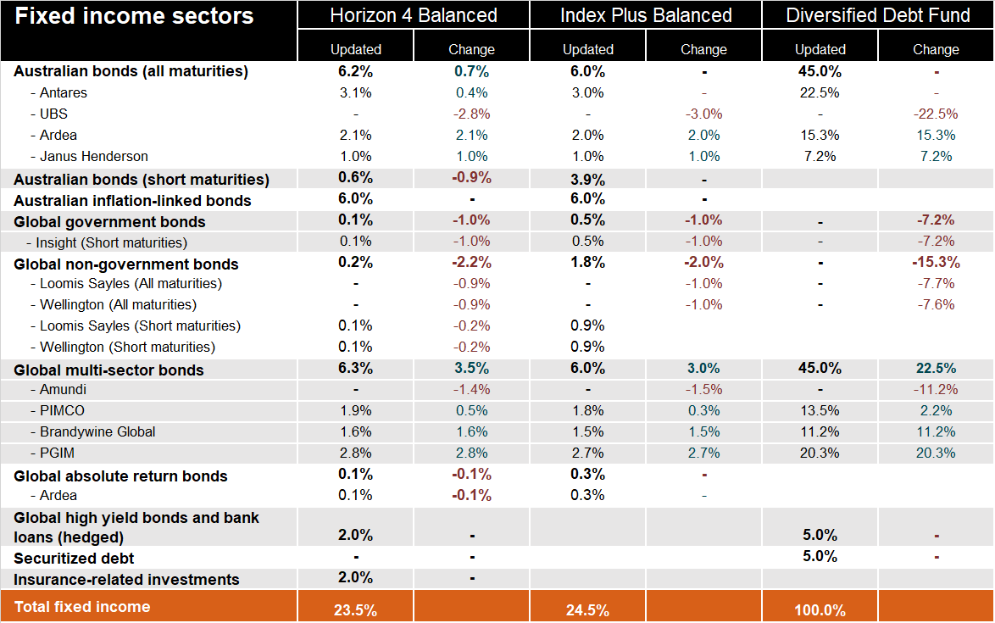
New target asset allocations MLC Wholesale
The same manager mix applies to MLC MasterKey Super and Pension Fundamentals and Business Super
Changes to MLC’s fixed income strategies and Diversified Debt Fund, for financial advisers

Slide 6
Profile of Ardea
Australian fixed income
About Ardea
Why we’ve appointed Ardea
Ardea has an extensive track record of delivering returns exceeding its benchmark (Bloomberg AusBond Composite 0+ Years Index). As the strategy does not rely on credit or directional trades to generate returns, it provides a good uncorrelated diversifier to other managers.
A key attraction is Ardea’s focus on capital preservation and ability to provide downside protection in stressed market conditions. The use of long only options provides a positive state which may add to the strategy’s defensive qualities during uncertainty and rising rates.
The strategy is focussed on micro relative value strategies and aims to deliver excess returns by exploiting small inefficiencies in fixed income markets. It excludes credit securities and is negatively correlated to and complements the more traditional Australian fixed income managers Antares (credit focus) and Janus Henderson (credit and interest rate duration focus).
The strategy offers daily liquidity, is invested in highly liquid instruments (holds mainly government and semi-government bonds), and has demonstrated the ability to stay liquid through the extreme illiquidity squeeze in Mar/Apr 2020.
Ardea is a manager in the MLC Premium Model Portfolios. These portfolios invest in the Ardea Real Outcome Fund. Ardea is also a global absolute return manager in some of our multi-asset portfolios.
Established in 2008 and based in Sydney.
Manages $25 billion (at 31 March 2022).
Majority of the business is owned by employees.
Ardea uses a ‘relative value’ approach which specifically identifies whether a bond is mispriced relative to other related securities with similar risk characteristics, and therefore has potential for its price to rise or fall.
Changes to MLC’s fixed income strategies and Diversified Debt Fund, for financial advisers

Slide 7
Profile of Janus Henderson
Australian fixed income
About Janus Henderson
Why we’ve appointed Janus Henderson
Established in 2017 through the merger of Henderson Global Investors (founded in the UK in 1934) and the Janus Capital Group (founded in the US in 1969). It’s headquartered in London.
Janus Henderson is a global asset manager which has a highly experienced and accomplished fixed income team based in Melbourne.
A key attraction of the team is its ability to access the Group’s broader global resources, as well as its nimbleness, as they have proven ability to quickly adjust the portfolio to the opportunities that present.
Its focus on credit and interest rate duration will complement Antares’ focus on credit.
The Janus Henderson Australian Fixed Interest Strategy we’re investing in, has a track record of delivering returns exceeding its benchmark (Bloomberg AusBond Composite 0+ Years Index) over the long term. The team uses multiple and diversified return drivers to generate risk controlled and risk scaled excess returns in its portfolios.
Janus Henderson has been a core Australian fixed income manager for IOOF since 2009.
Manages $480.7 billion (at 31 March 2022).
Parent company Janus Henderson Group plc is dual listed on the New York Stock Exchange (NYSE) and Australian Securities Exchange (ASX).
The Australian Fixed Interest team at Janus Henderson believes that investment markets are inefficient, causing market pricing to overshoot ‘fair value’ levels. They believe that by applying a rational and disciplined valuation framework, an active approach in both interest rate and credit management can take advantage of these market overshoots and deliver superior risk adjusted returns over time. They focus their research on three key areas: economic, market trends, and credit.
Changes to MLC’s fixed income strategies and Diversified Debt Fund, for financial advisers

Slide 8
Profile of Brandywine Global
Global fixed income
About Brandywine Global
Why we’ve appointed Brandywine Global
Established in 1986 and based in Philadelphia.
Manages firmwide US$67.1 billion. Global fixed income is US$47.0 billion (as at 31 March 2022).
The strategy aims to protect capital whilst seeking an attractive income, with an emphasis on strong, risk-adjusted total returns relative to the benchmark. It can invest in both government and non-government fixed income, including emerging markets and currencies.
A key attraction of the strategy are its flexible guidelines, which enable the team to respond to the business cycle, rotate portfolio positions according to the economic environment, and proactively manage interest rate and credit risks - while simultaneously considering sector allocation, security selection, duration, credit quality, and currency - for attractive risk-adjusted return potential.
The strategy has a track record of outperforming its benchmark.
The strategy is managed by a long-tenured investment team who bring together demonstrated global sector experience.
Brandywine Global is a high conviction manager. It has low correlation with, and complements, the benchmark aware and low tracking error managers PIMCO and PGIM.
Brandywine Global has been a global multi-sector fixed income manager for IOOF since 2011.
Brandywine Global is an independent affiliate investment manager of Franklin Templeton. Brandywine Global retains full control over investments, hiring and compensation.
Brandywine Global is a global multi-sector fixed income manager who applies a differentiated, proven process that combines top-down analysis of macroeconomic conditions with bottom-up fundamental research. They seek to identify global, cross-sector opportunities that they believe offer the most compelling combinations of valuations and durable fundamentals.
The customised Brandywine Global multi-sector fixed income strategy used in our strategy takes meaningful deviations from the benchmark (Bloomberg Barclays Global Aggregate Index). It is considered benchmark agnostic, meaning it may experience higher tracking error and periods of both significant outperformance or underperformance relative to the benchmark.
Changes to MLC’s fixed income strategies and Diversified Debt Fund, for financial advisers

Slide 9
Profile of PGIM
Global fixed income
About PGIM
Why we’ve appointed PGIM
PGIM Fixed Income operates primarily through PGIM, Inc. (PGIM).
PGIM was established in 1984 and is based in New Jersey.
The strategy is managed based on the philosophy that research-driven security selection is the most consistent strategy for adding value to portfolios. They complement that base strategy with modest sector rotation, duration management, and disciplined trade execution. Risk budgeting is central to their approach.
The strategy seeks to achieve excess returns from sector allocations; sub-sector and securities allocations, and duration.
A key attraction of the PGIM is its superior ability to consistently add excess returns across the entire business cycle, particularly relative to other fixed income managers. Over a rolling 5 year period, PGIM has consistently exceeded its return target.
Relative to the other fixed income managers, PGIM has an extremely low correlation to global shares. The strategy complements the benchmark aware and low tracking error manager PIMCO. PGIM’s strong risk control focus also means it complements benchmark agnostic manager Brandywine Global.
PGIM has been a global multi-sector fixed income manager for IOOF since 2021.
PGIM Fixed Income manages $890 billion (at 31 March 2022).
PGIM is one of the largest fixed income managers in the US and has been managing fixed income money since 1875.
PGIM’s origins from managing proprietary fixed income assets has lent the manager to a culture of rigorous risk management and a focus on investing in areas that generate the highest risk-adjusted returns.
The PGIM global multi-sector core bond strategy seeks to outperform across the majority of sectors contained in its benchmark (Bloomberg Global Aggregate Index).
The strategy may invest in developed and emerging foreign government and non-government bonds; investment-grade developed market mortgages and mortgage-related securities; and in developed and emerging short- and long-term bank debt securities or deposits. The strategy may also invest in derivatives to generate excess returns and hedge risk exposures.
Changes to MLC’s fixed income strategies and Diversified Debt Fund, for financial advisers

Slide 10
Communication plan
When | Who | What | Where
Mid-late May | Advisers | This presentation outlining the changes | Internal mlcamcomms email to BDMs Included in Adviser Bulletin email to advisers Published in adviser sections of mlc.com.au and mlcam.com.au (in ‘Strategy updates’ section)
Late July | Advisers | Investment update for financial advisers MLC’s scenario insights & portfolio positioning MLC wholesale fixed income funds update | Published on mlc.com.au (in Fund Commentaries, under Prices and Performance accessed from Adviser tab) and mlcam.com.au (under ‘Latest quarterly reporting resources’ in ‘Adviser only’ section)
Late July | Advisers and clients | Fund commentaries | mlc.com.au/fundprofiletool mlcam.com.au/MLCWholesale, select Fund Profile Tool
Changes to MLC’s fixed income strategies and Diversified Debt Fund, for financial advisers

