Slide 1
Addition of insurance-related investments to MLC Horizon portfolios
for financial advisers
January 2022
This material is not for circulation to retail investors

Slide 2
Important information
This information has been provided for the funds in the table below by MLC Investments Limited (ABN 30 002 641 661 AFSL 230705) as Responsible Entity for the MLC Investment Trust, NULIS Nominees (Australia) Limited (ABN 80 008 515 633, AFSL 236465) as trustee of the MLC MasterKey Fundamentals Super and Pension and MLC MasterKey Business Super products which are a part of the MLC Super Fund (ABN 70 732 426 024), part of the IOOF group of companies (comprising IOOF Holdings Ltd ABN 49 100 103 722 and its related bodies corporate) (‘IOOF Group’). The capital value, payment of income, and performance of the Funds are not guaranteed. An investment in the Funds is subject to investment risk, including possible delays in repayment of capital and loss of income and principal invested. No member of the IOOF Group guarantees or otherwise accepts any liability in respect of any financial product referred to in this communication
This presentation has been prepared for licensed financial advisers only. This document must not be distributed to “retail clients” (as defined in the Corporations Act 2001 (Cth)) or any other persons. This information is directed to and prepared for Australian residents only.
Some information contained in this presentation may constitute general advice. It has been prepared without taking account of an investor’s objectives, financial situation or needs and because of that an investor should, before acting on the advice, consider the appropriateness of the advice having regard to their personal objectives, financial situation and needs. Investors should obtain a Product Disclosure Statement or other disclosure document relating to any financial product which is issued by MLC and consider it before making any decision about whether to acquire or continue to hold the product. A copy of the Product Disclosure Statement or other disclosure document is available upon request by phoning the MLC call centre on 132 652 or on our website at mlc.com.au.
Past performance is not a reliable indicator of future performance. The value of an investment may rise or fall with the changes in the market. Please note that all performance reported is before management fees and taxes, unless otherwise stated.
Any projection or other forward-looking statement (‘Projection’) in this document is provided for information purposes only. Whilst reasonably formed, no representation is made as to the accuracy of any such Projection or that it will be met. Actual events may vary materially.
The information in this communication is indicative and prepared for information purposes only and does not purport to contain all matters relevant to any particular investment or financial instrument. Any opinions expressed in this communication constitute our judgement at the time of issue. We believe that the information contained in this communication is correct and that any estimates, opinions, conclusions or recommendations are reasonably held or made at the time of compilation. However, no warranty is made as to their accuracy or reliability. The information in this communication is subject to change without notice, and we shall not be under any duty to update or correct it. All statements as to future matters are not guaranteed to be accurate and any statements as to past performance do not represent future performance. We may rely on third parties to provide certain information. We are not responsible for its accuracy or liable for any loss arising from person relying on information provided by third parties. Subject to any terms implied by law and which cannot be excluded, we shall not be liable for any errors, omissions, defects or misrepresentations in this communication (including by reasons of negligence, negligent misstatement or otherwise) or for any loss or damage (whether direct or indirect) suffered by persons who use or rely on the communication.
While MLC has taken all reasonable care in producing this communication, subsequent changes in circumstances may occur and impact on its accuracy. The investment managers are current as at the date this communication was prepared. Investment managers are regularly reviewed and may be appointed or removed at any time without prior notice to you.
Bloomberg Finance L.P. and its affiliates (collectively, “Bloomberg”) do not approve or endorse any information included in this material and disclaim all liability for any loss or damage of any kind arising out of the use of all or any part of this material.
The following funds are affected by the addition of MLC’s insurance-related investments strategy. These funds appear on MLC’s platforms and external platforms:
MLC Horizon 2 Capital Stable Portfolio MLC Wholesale Horizon 2 Income Portfolio
MLC Horizon 2 Income Portfolio MLC Wholesale Horizon 3 Conservative Growth Portfolio
MLC Horizon 3 Conservative Growth Portfolio MLC Wholesale Horizon 4 Balanced Portfolio
MLC Horizon 4 Balanced Portfolio MLC Wholesale Horizon 5 Growth Portfolio
MLC Horizon 5 Growth Portfolio

Slide 3
What’s changed?
What’s changed?
Client benefits
We believe insurance-related investments provide the following client benefits, in current market conditions:
Diversification of returns, because returns from insurance-related investments aren’t driven by financial markets, and
a stable and higher income yield than other types of fixed income.
2% of the MLC Horizon portfolios has been allocated to insurance-related investments.
In the current environment of low yields from traditional fixed income, insurance-related investments are expected to provide a healthy, stable yield that’s higher than other fixed income investments.
Returns from insurance-related investments are driven by factors other than economic growth, inflation and credit risk, providing a valuable source of income diversification.
The allocation has been funded by reducing exposure to inflation-linked bonds, short and all-maturities Australian and global bonds.
Implementation occurred at the end of December 2021.
This direct allocation adds to the portfolios’ small existing exposure to insurance-related investments inherited from investments in the MLC Inflation Plus portfolios.
Funds affected
MLC Horizon 2 to 5 portfolios are affected by these changes.
These funds have fixed fees which aren’t changing as a result of these changes. There is negligible impact on indirect costs.
Addition of insurance-related investments to MLC Horizon portfolios, for financial advisers

Slide 4
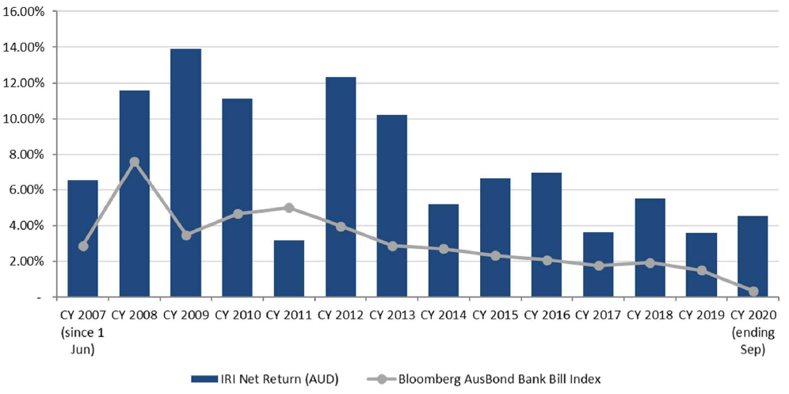
Why invest in insurance-related investments?
Insurance-related investments are investments in natural catastrophe risks. Investors take on the role of an insurer. They receive a yield – effectively an insurance premium – for taking the risk of a particular natural catastrophe causing losses above a certain level. As the occurrence of natural catastrophes has no expected correlation with share market movements, the strategy is an attractive source of diversification. For example, during the global financial crisis, shares fell but insurance-related investments performed well.
While insurance-related investments have a long-term return and risk profile similar to other types of fixed income investments, insurance-related investments’ returns can be distinctly different over short periods (see chart) because the underlying assets generating the income are
linked to the insurance market. As a result, insurance-related investments provide excellent diversification benefits to other types of fixed income, reducing total portfolio risk and improving the risk-return efficiency of the portfolios. The ~5% expected yield is a significant improvement on the <3% yield currently provided by US and Australian investment grade bonds.
Another distinctive feature of these investments is the visibility regarding its risk-return profile. Unlike other asset classes, where generally the expected returns are higher when risks are higher, in reinsurance the risks of a catastrophe occurring does not change materially from year to year, but the pricing can. The main factor influencing prices is the occurrence of natural catastrophe events. After a major event, premiums (returns) increase. With the western European flooding and Hurricane Ida occurring recently, reinsurance pricing and coverage terms are both likely to continue the trend of recent years towards higher premium rates and tighter coverage terms, providing an opportunity for the Horizon portfolios to invest while prices are attractive.
Insurance-related investments’ returns (net of indirect costs) vs cash
Source: MLC Asset Management Services Limited. Data to 30 September 2021.

Slide 5
How we manage insurance-related investments
The insurance-related investments strategy, managed by MLC’s Alternative Strategies team, uses carefully selected specialist reinsurance managers from around the world.
MLC’s Alternative Strategies team have appointed three specialist reinsurance managers with expertise in the management of natural catastrophe and weather-related reinsurance risk exposures.
Our insurance-related investments strategy consists of a combination of catastrophe bonds (~15%) as well as direct reinsurance. The direct reinsurance market is a much larger pool of exposures compared to the catastrophe bond market, which creates more opportunity. This is where investing through specialist reinsurance managers is most advantageous to our investors. These managers and their parent companies are extremely well positioned to source and sift attractive risks from insurance companies and analyse these risks accurately. One example of this is demonstrated in the research team of one of our managers, which consists of 30+ people, including seismologists and weather experts, whose job is to accurately assess the risk of loss from various events. Importantly, this manager retains exposure to all the risks to which MLC’s portfolios are exposed, which creates a strong alignment of interest.
Expected risk by catastrophe type
Source: MLC Asset Management Services Limited. Data at 30 September 2021.
Addition of insurance-related investments to MLC Horizon portfolios, for financial advisers

Slide 6
Communication plan
When | Who | What | Where
Mid January | Advisers | This presentation outlining the changes | Included in Adviser Bulletin email to advisers Published in adviser sections of mlc.com.au and mlcam.com.au (in ‘Strategy updates’ section) Included in MLC News email to advisers and published on MyNews
Late January | Advisers | Investment update for financial advisers – January 2022 | Included in Adviser Bulletin email to advisers Published on mlc.com.au (in Fund Commentaries, under Prices and Performance accessed from Adviser tab) and mlcam.com.au (under ‘Latest quarterly reporting resources’ in ‘Adviser only’ section)
Late January | Advisers and clients | Fund commentaries | mlc.com.au/fundprofiletool mlcam.com.au/MLCWholesale, select Fund Profile Tool
More information on insurance-related investments is available in an update we produce each quarter, available here.
Addition of insurance-related investments to MLC Horizon portfolios, for financial advisers

