Slide 1
Addition of global listed infrastructure to MLC portfolios
for financial advisers
October 2021
This material is not for circulation to retail investors

Slide 2
Important information
This information has been provided for the funds in the table below by Navigator Australia Limited (ABN 45 006 302 987 AFSL 236466) as Responsible Entity for the MLC Pre Select Funds, MLC Investments Limited (ABN 30 002 641 661 AFSL 230705) as Responsible Entity for the MLC Investment Trust, NULIS Nominees (Australia) Limited (ABN 80 008 515 633, AFSL 236465) as trustee of the MLC MasterKey Fundamentals Super and Pension and MLC MasterKey Business Super products which are a part of the MLC Super Fund (ABN 70 732 426 024), part of the IOOF group of companies (comprising IOOF Holdings Ltd ABN 49 100 103 722 and its related bodies corporate) (‘IOOF Group’). The capital value, payment of income, and performance of the Funds are not guaranteed. An investment in the Funds is subject to investment risk, including possible delays in repayment of capital and loss of income and principal invested. No member of the IOOF Group guarantees or otherwise accepts any liability in respect of any financial product referred to in this communication
This presentation has been prepared for licensed financial advisers only. This document must not be distributed to “retail clients” (as defined in the Corporations Act 2001 (Cth)) or any other persons. This information is directed to and prepared for Australian residents only.
Some information contained in this presentation may constitute general advice. It has been prepared without taking account of an investor’s objectives, financial situation or needs and because of that an investor should, before acting on the advice, consider the appropriateness of the advice having regard to their personal objectives, financial situation and needs. Investors should obtain a Product Disclosure Statement or other disclosure document relating to any financial product which is issued by MLC and consider it before making any decision about whether to acquire or continue to hold the product. A copy of the Product Disclosure Statement or other disclosure document is available upon request by phoning the MLC call centre on 132 652 or on our website at mlc.com.au.
Past performance is not a reliable indicator of future performance. The value of an investment may rise or fall with the changes in the market. Please note that all performance reported is before management fees and taxes, unless otherwise stated.
Any projection or other forward-looking statement (‘Projection’) in this document is provided for information purposes only. Whilst reasonably formed, no representation is made as to the accuracy of any such Projection or that it will be met. Actual events may vary materially.
The information in this communication is indicative and prepared for information purposes only and does not purport to contain all matters relevant to any particular investment or financial instrument. Any opinions expressed in this communication constitute our judgement at the time of issue. We believe that the information contained in this communication is correct and that any estimates, opinions, conclusions or recommendations are reasonably held or made at the time of compilation. However, no warranty is made as to their accuracy or reliability. The information in this communication is subject to change without notice, and we shall not be under any duty to update or correct it. All statements as to future matters are not guaranteed to be accurate and any statements as to past performance do not represent future performance. We may rely on third parties to provide certain information. We are not responsible for its accuracy or liable for any loss arising from person relying on information provided by third parties. Subject to any terms implied by law and which cannot be excluded, we shall not be liable for any errors, omissions, defects or misrepresentations in this communication (including by reasons of negligence, negligent misstatement or otherwise) or for any loss or damage (whether direct or indirect) suffered by persons who use or rely on the communication.
While MLC has taken all reasonable care in producing this communication, subsequent changes in circumstances may occur and impact on its accuracy. The investment managers are current as at the date this communication was prepared. Investment managers are regularly reviewed and may be appointed or removed at any time without prior notice to you.
The following funds are affected by the addition of MLC’s Infrastructure strategy. These funds appear on MLC’s platforms and external platforms:
MLC Horizon 2 Capital Stable Portfolio MLC Wholesale Horizon 2 Income Portfolio MLC Pre Select Conservative Fund
MLC Horizon 2 Income Portfolio MLC Wholesale Horizon 3 Conservative Growth Portfolio MLC Pre Select Balanced Fund
MLC Horizon 3 Conservative Growth Portfolio MLC Wholesale Horizon 4 Balanced Portfolio MLC Pre Select Growth Fund
MLC Horizon 4 Balanced Portfolio MLC Wholesale Horizon 5 Growth Portfolio MLC Pre Select High Growth Fund
MLC Horizon 5 Growth Portfolio MLC Wholesale Horizon 6 Share Portfolio MLC Inflation Plus Conservative Portfolio
MLC Horizon 6 Share Portfolio MLC Wholesale Horizon 7 Accelerated Growth Portfolio MLC Inflation Plus Moderate Portfolio
MLC Horizon 7 Accelerated Growth Portfolio MLC Wholesale Inflation Plus Conservative Portfolio MLC Inflation Plus Assertive Portfolio
MLC Wholesale Inflation Plus Moderate Portfolio MLC Wholesale Inflation Plus Assertive Portfolio

Slide 3
What’s changed?
What’s changed?
Client benefits
We believe infrastructure provides the following client benefits:
diversification, because infrastructure returns are different from other asset classes, and
it helps insulate the portfolios from rising inflation.
Added an allocation to a new global listed infrastructure strategy which provides market exposure (after deducting fees).
The global listed infrastructure market index is economically and geographically diversified, represented by the FTSE Developed Core Infrastructure 50/50 Index ($A hedged). It comprises:
companies that generate more than 65% of their revenue from core infrastructure activities
50% Utilities, 30% Transport, and 20% Other (including pipelines, satellites, and telecommunication towers).
Funds affected
Funds affected are:
MLC Horizon 2 to 7 portfolios
MLC Inflation Plus portfolios, and
MLC Pre Select funds.
The funds have fixed fees which aren’t changing as a result of these changes. Negligible impact on indirect costs.
Addition of global listed infrastructure to MLC portfolios, for financial advisers

Slide 4
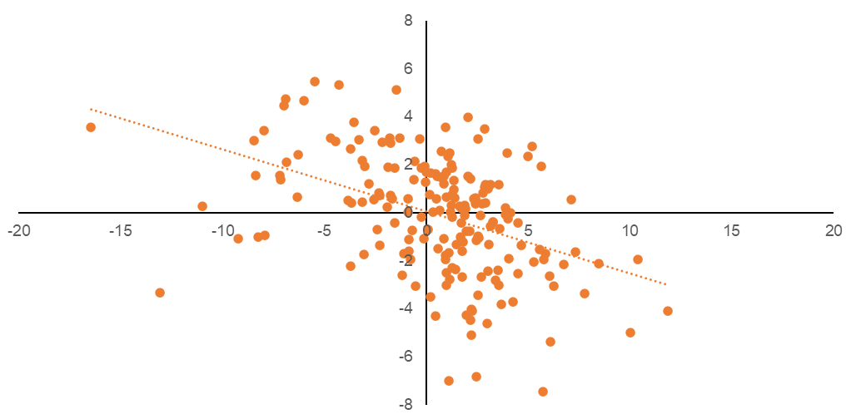
Why invest in infrastructure?
In an environment of low interest rates, fixed income is unable to fulfil its traditionally defensive role in a portfolio. It provides little to no income with high valuations and inflation risks.
Returns from infrastructure are different to other asset classes. The chart demonstrates this diversification; when global share markets are weak, global listed infrastructure tends to outperform and vice versa (shaded quadrants).
Infrastructure fulfils a role in the portfolios, across multiple potential scenarios:
In scenarios where inflation moves higher (a scenario that’s increasing in probability), returns from infrastructure may be beneficial because infrastructure assets, particularly in regulated sectors like utilities, deliver stable earnings growth and cash flows which tend to increase as inflation rises.
The long-term nature of infrastructure cash flows sees them perform well in environments of falling real yields (ie yields in excess of inflation), not unlike the one that’s prevailed for much of the last decade.
The long-term characteristics of infrastructure means they tend to outperform other growth assets should economic condition sour.
Additional favourable characteristics of infrastructure include:
infrastructure’s yield in excess of inflation (ie real yield) is typically higher than other alternatives, and
global listed infrastructure is less volatile than global listed shares.
We’re using an index, rather than active, approach as it’s more suited to our portfolios at this time. Active managers tend to take significant bets, can underperform and outperform for extended periods, and are relatively expensive.
Infrastructure has provided diversification from global shares
Weak share markets and infrastructure outperforms
Strong share markets and infrastructure outperforms
Global listed infrastructure excess returns to global shares (monthly returns %)
Weak share markets and infrastructure underperforms
Strong share markets and infrastructure underperforms
Global share monthly returns (%)
Source: MLC Asset Management Services Limited. Based on price returns (in local currency) for MSCI World Index and FTSE Developed Core Infrastructure 50/50 Index

Slide 5
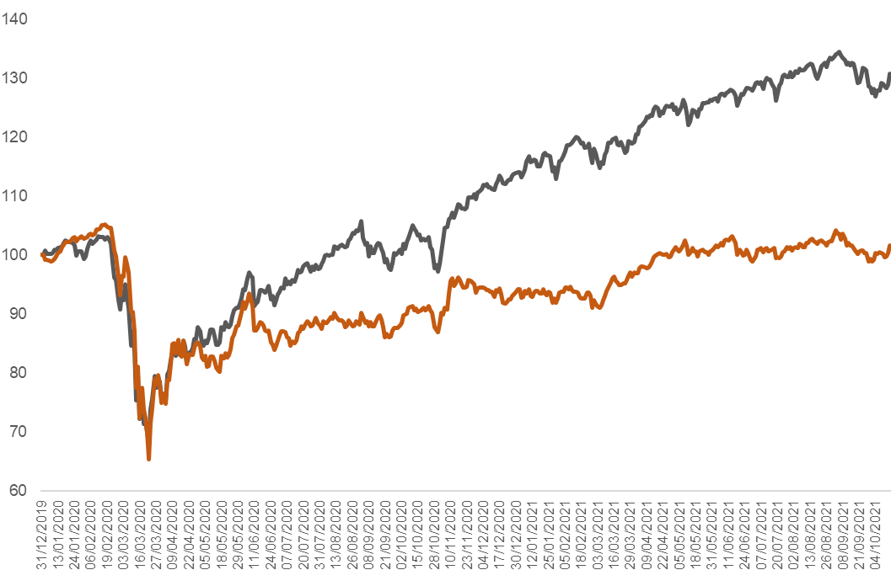
Some of the risks
Infrastructure values may be challenged in a rising interest rate environment because discount rates, used in valuations, also rise. However, the stable, and inflation-linked, revenues of many infrastructure sectors should provide some insulation from rising interest rates.
Although global listed infrastructure valuations are above historical averages, they haven’t seen the same growth as global share markets during the pandemic (see chart).
While higher interest rates could weaken prices, economically-sensitive infrastructure assets adversely impacted by COVID-19 have reduced in price (eg airports and tollroads), providing upside return potential as economies recover. Of course, this is only a component of the broader index.
We were concerned about potential environmental risks of the use of fossil fuels by some US utilities. However, we found there are already significant plans across most infrastructure companies to divest from coal and gas, with high amounts of capex planned for renewable energy projects over the next 10+ years. Additionally, some companies have already transitioned to 100% renewables.
Global shares vs infrastructure
MSCI World Index
FTSE Developed Core Infrastructure 50/50 Index
Source: MLC Asset Management Services Limited. Based on price index in USD, Index = 100 on 31/12/19.
Addition of global listed infrastructure to MLC portfolios, for financial advisers

Slide 6
Implementation
Inflation Plus portfolios
Horizon 2 to 7 portfolios
Pre Select funds
The new global listed infrastructure strategy replaces Inflation Plus portfolios’ previous exposure to infrastructure, implemented using derivatives in December 2020
The allocation to infrastructure has been funded by reducing global shares (hedged), inflation-linked bonds and inflation plus
Infrastructure is currently part of the alternatives allocation
Pre Select funds are aligned to Horizon portfolios so the changes are similar to Horizon portfolios
Inflation Plus portfolio | Allocation to infrastructure
Conservative | 3%
Moderate | 3%
Assertive | 3%
Horizon portfolio | Allocation to infrastructure
Horizon 2 | 1%
Horizon 3 | 2%
Horizon 4 and 5 | 3%
Horizon 6 and 7 | 2%
Pre Select fund | Allocation to infrastructure
Conservative | 1%
Balanced | 2%
Growth | 3%
High Growth | 3%
Implemented at the end of September
We’ll update you when global listed infrastructure is added to other MLC multi-manager portfolios
Addition of global listed infrastructure to MLC portfolios, for financial advisers

Slide 7
Communication plan
When | Who | What | Where
Mid October | Advisers | This presentation outlining the changes | Included in Adviser Bulletin email to advisers Published in adviser sections of mlc.com.au and mlcam.com.au (in ‘Strategy updates’ section) Included in MLC News email to advisers and published on MyNews
Late October | Advisers | Investment update for financial advisers – October 2021 | Included in Adviser Bulletin email to advisers Published on mlc.com.au (in Fund Commentaries, under Prices and Performance accessed from Adviser tab) and mlcam.com.au (under ‘Latest quarterly reporting resources’ in ‘Adviser only’ section)
Late October | Advisers and clients | Fund commentaries | mlc.com.au/fundprofiletool mlcam.com.au/MLCWholesale, select Fund Profile Tool
Addition of global listed infrastructure to MLC portfolios, for financial advisers

