Slide 1
MLC Popular chart pack
This presentation is not for circulation to
retail investors

Slide 2
Important information
Data as at 31 December 2024 unless otherwise stated.
The information in this presentation has been provided by MLC Investments Limited (ABN 30 002 641 661, AFSL 230705), a part of the Insignia Financial Group of companies (comprising Insignia Financial Ltd ABN 49 100 103 722 and its related bodies corporate) (‘Insignia Financial Group’). The capital value, payment of income and performance of any financial product referred to in this communication are not guaranteed. An investment in any financial product referred to in this communication is subject to investment risk, including possible delays in repayment of capital and loss of income and principal invested. No member of the Insignia Financial Group guarantees or otherwise accepts any liability in respect of any financial product referred to in this communication.
This presentation has been prepared for licensed financial advisers only. This document must not be distributed to “retail clients” (as defined in the Corporations Act 2001 (Cth)) or any other persons.
This information is directed to and prepared for Australian residents only.
This information may constitute general advice. It has been prepared without taking account of an investor’s objectives, financial situation or needs and because of that an investor should, before acting on the advice, consider the appropriateness of the advice having regard to their personal objectives, financial situation and needs. You should obtain a Product Disclosure Statement (PDS) relating to the financial products mentioned in this communication issued by MLC Investments Limited and consider it before making any decision about whether to acquire or continue to hold these products. Target Market Determinations (TMDs) for relevant products are also required to be made available and considered by distributors. A copy of the PDS (or other disclosure documents) and TMD is available upon request by phoning the MLC call centre on 132 652 or by searching for the applicable product on our website at mlc.com.au
Past performance is not a reliable indicator of future performance. The value of an investment may rise or fall with the changes in the market. The performance returns in this communication are reported before deducting management fees and taxes unless otherwise stated. Actual returns may vary from any target return described in this presentation and there is a risk that the investment may achieve lower than expected returns.
Any opinions expressed in this presentation constitute our judgement at the time of issue and are subject to change. We believe that the information contained in this presentation is correct and that any estimates, opinions, conclusions or recommendations are reasonably held or made at the time of compilation. However, no warranty is made as to their accuracy or reliability (which may change without notice) or other information contained in this presentation. MLC Investments Limited relies on third parties to provide certain information and is not responsible for its accuracy. MLC Investments Limited is not liable for any loss arising from persons relying on information provided by third parties. MLC Investments Limited may use the services of Insignia Financial Group where it makes good business sense to do so and will benefit customers. Amounts paid for these services are always negotiated on an arm’s length basis.
Bloomberg Finance L.P. and its affiliates (collectively, “Bloomberg”) do not approve or endorse any information included in this material and disclaim all liability for any loss or damage of any kind arising out of the use of all or any part of this material.
The funds referred to herein are not sponsored, endorsed, or promoted by MSCI, and MSCI bears no liability with respect to any such fund.

Slide 3
Index
Chart | Slide number
Cash and term deposit rates rise as often as they fall | 4
Consistency of dividend returns | 5
The story of income growth | 6
Growth of an investment in the Australian share market over 20 years | 7
Own or loan? | 8
Shares have outperformed cash | 9
The impact of inflation | 10
Days out of the market will erode your wealth | 11
Growing your wealth through a regular investment strategy | 12
Staying invested would have kept you ahead (‘the chaser’) | 13
Comparison of returns from global shares and term deposits since 2002 | 14
Impact of world events on investment markets | 15
History of returns for global shares | 16

Slide 4
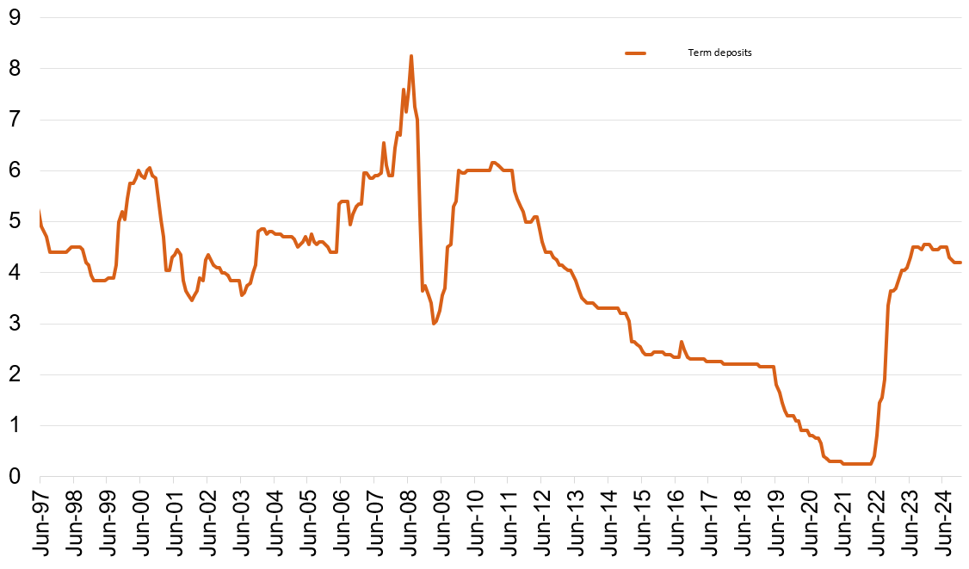
Cash and term deposit rates rise as often as they fall
One year term deposit rates (based on $10,000 deposit)
Term deposits
The RBA cash rate is 4.35% and a 1 year term deposit rate with the National Australia Bank is 4.20%
1 year term deposit rates %
With low term deposit rates, you may not get the level of growth and income you need to achieve your goals
Past performance is not a reliable indicator of future performance.
Sources: MLC Asset Management Services Limited, Reserve Bank of Australia (RBA). Data as at 31 December 2024. Based on banks’ 1 year term deposit rates ($10,000).

Slide 5
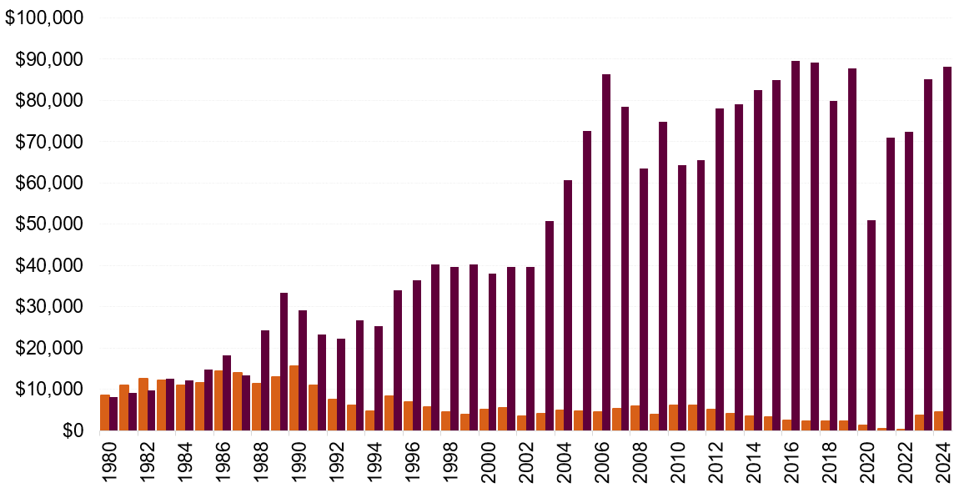
Consistency of dividend returns Income from term deposits was higher initially, but income from shares grew significantly
Income on an investment of $100,000 in December 1980 – December 2024
Income
Year ended 31 December
Annual income from 1 year term deposits
Annual income from shares (industrials index)
Past performance is not a reliable indicator of future performance.
Source: Calculations by MLC Asset Management Services Limited. Shares – represented by the ASX Industrials Total Return and Price Indices. Income calculated as the difference between the return of the accumulation and price indices, multiplied by capital value. Term deposit – represented by the Reserve Bank of Australia (RBA) 12 month Banks’ Term Deposits ($10,000), prior to January 1982, the RBA 12 month Term Deposit rate ($5000 - $10,000). All data assumes income is not re-invested.

Slide 6
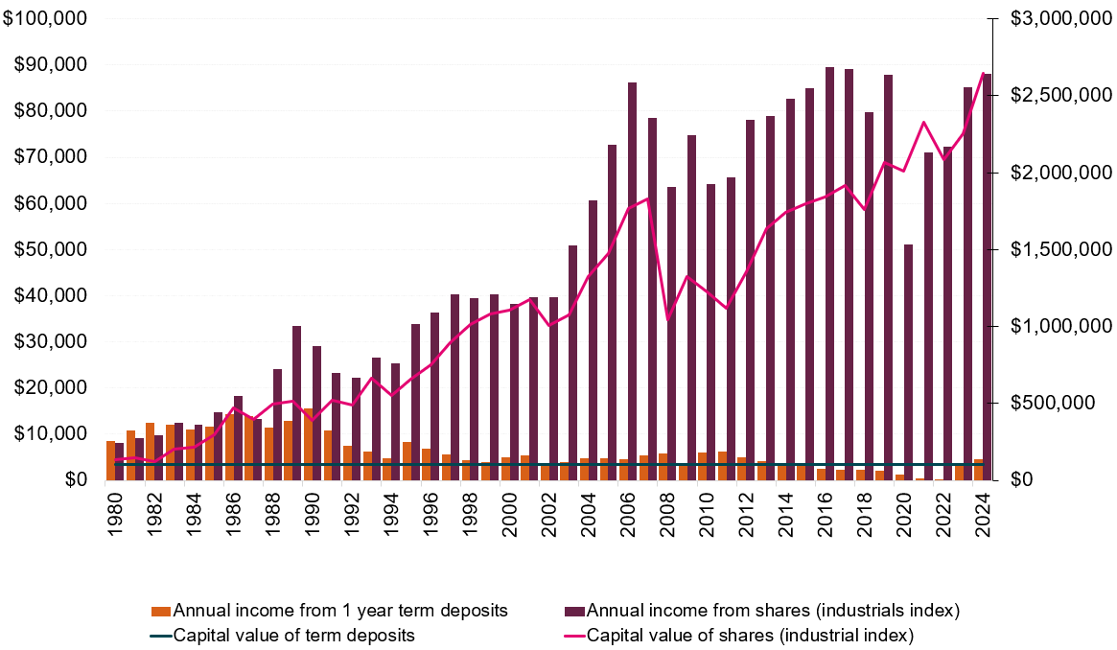
The story of income growth Shares vs term deposits
Income and capital return on an investment of $100,000 in December 1980 – December 2024
Income
Dividends (income) from a share portfolio
Over time, the annual income from quality
shares has typically outgrown the income
from term deposits.
Capital growth of share portfolio
Capital value
Interest from a term deposit
In the first few years, the
annual income from term
deposits was higher than
income from a share portfolio
Capital value of term deposit does not grow
Year ended 31 December
Annual income from 1 year term deposits
Annual income from shares (industrials index)
Capital value of term deposits
Capital value of shares (industrials index)
Past performance is not a reliable indicator of future performance. Source: Based on calculations by MLC Asset Management Services Limited as at 31 December 2024 and based on market index data. Shares - are based on S&P/ASX 200 Industrial index, which historically comprises of companies that pay higher dividend yield and franking credits. S&P/ASX 200 Industrial Total Return and Price Return indices are not generally representative of returns from shares or sectors, other than the industrial sector, during the period and do not depict returns from global shares. Term Deposit – represented by the Reserve Bank of Australia (RBA) 12 month Banks’ Term Deposits ($10,000), prior to January 1982, the RBA 12 month Term Deposit rate ($5000 - $10,000). All data assumes income is not re-invested. The story of income growth does not account for the impact of inflation over the period, does not take into account management fees and the impact that individual taxation circumstances may have on the final ‘net-of-tax’ position of returns.

Slide 7
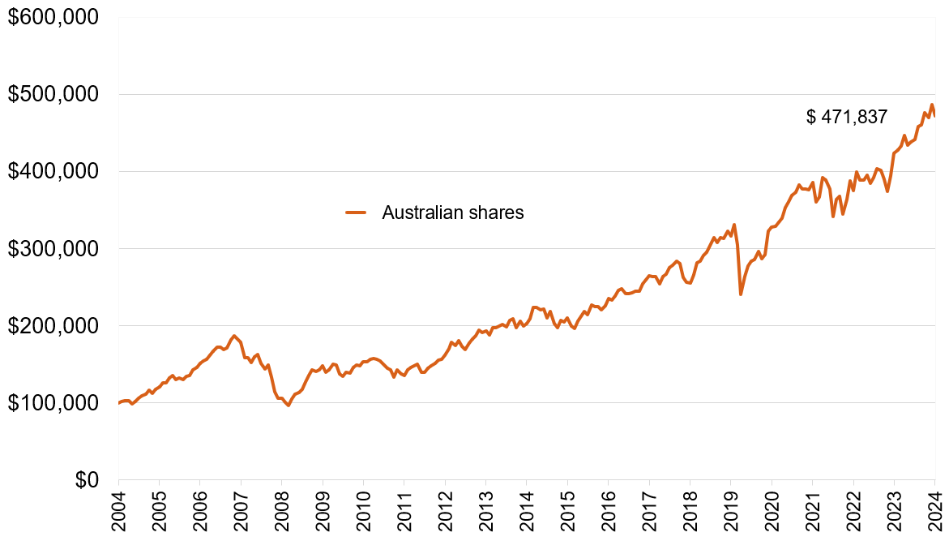
Growth of an investment in the Australian share market over 20 years
Value of $100,000 invested over 20 years (income reinvested)
Past performance is not a reliable indicator of future performance.
Source: MLC Asset Management Services Limited, data updated to 31 December 2024. Australian Shares: ASX All Ordinaries Total Return Index.

Slide 8
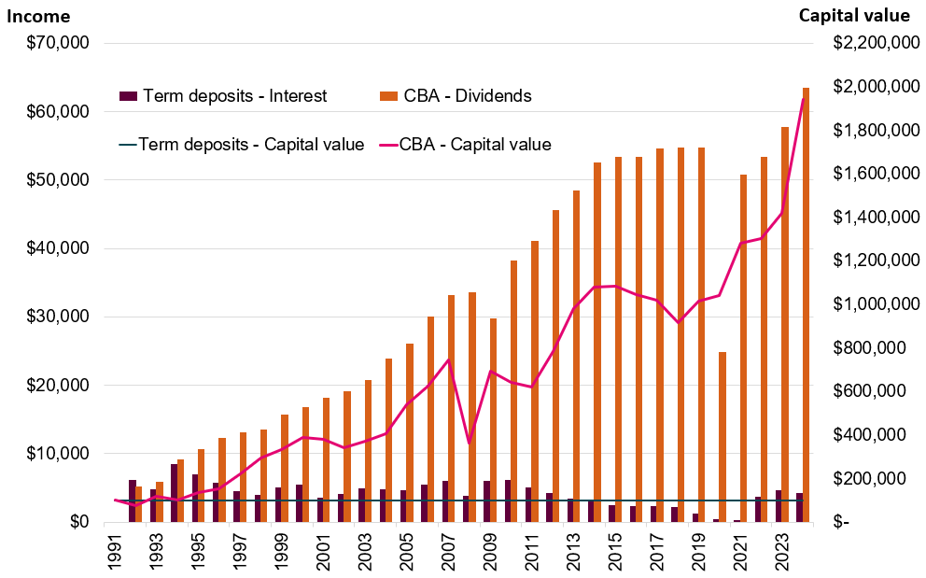
Own or loan? Income and growth of a term deposit with CBA vs owning CBA shares
Investment of $100,000 in December 1991 – December 2024
Past performance is not a reliable indicator of future performance.
Source: Calculations by MLC Asset Management Services Limited. Based on data from FactSet and Reserve Bank of Australia.

Slide 9
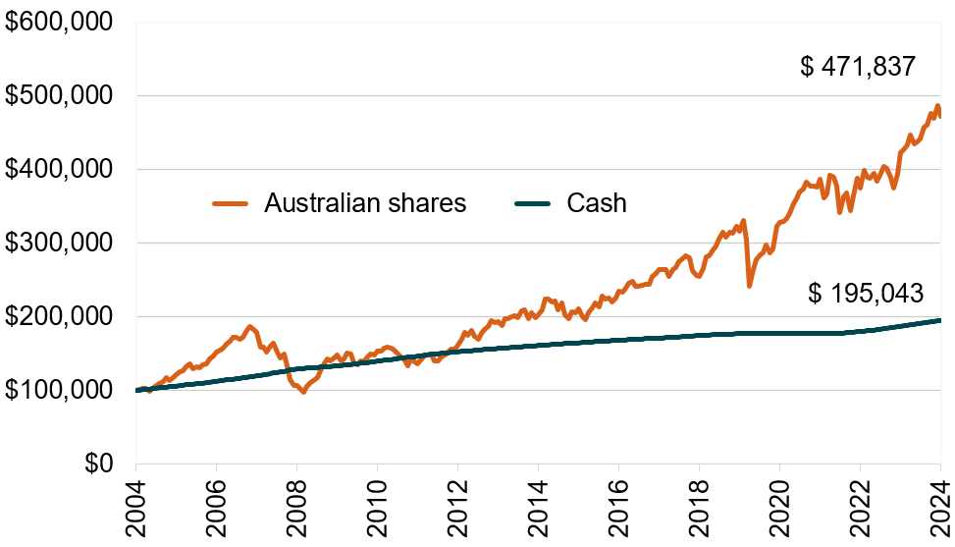
Shares have outperformed cash Over the past 20 years, an investment in shares provided significantly more growth than an investment in cash
Value of $100,000 invested over 20 years (income reinvested)
Past performance is not a reliable indicator of future performance.
Source: FactSet, based on market index data updated to 31 December 2024. Australian shares: ASX All Ordinaries Accumulation Index.
Cash: Bloomberg AusBond Bank Bill Index.

Slide 10
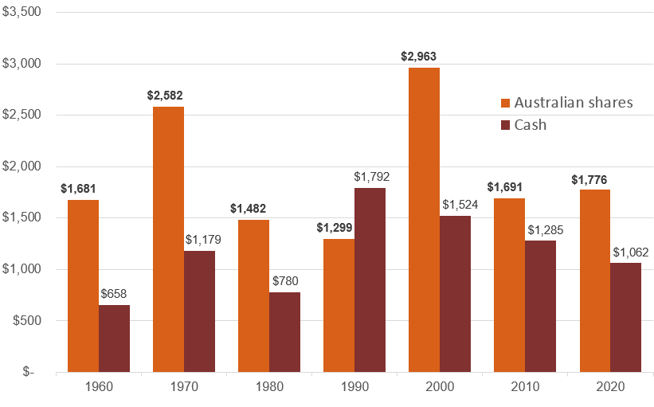
The impact of inflation Cash vs Australian shares
Value of $1,000 invested for 10 years (taking into account inflation)
Value of investment (above inflation)
Past performance is not a reliable indicator of future performance.
Source: Data calculated over 10 year periods by MLC Asset Management Services Limited using data provided by Global Financial Data, Inc.
and Thomson Reuters Datastream.

Slide 11
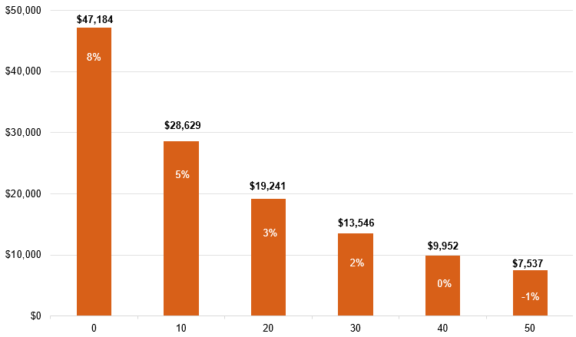
Days out of the market will erode your wealth Missing the best days in the market. Australian shares and performance return
Value of $10,000 invested over 20 years (December 2004 – December 2024)
Number of ‘best’ days missed
Past performance is not a reliable indicator of future performance.
Source: Calculations by MLC Asset Management Services Limited. The ‘market’ is the Australian share market and is represented by the
ASX All Ordinaries Total Return Index. Returns shown are an average annual return over 20 years.

Slide 12
Growing your wealth through a regular investment strategy
Dollar cost averaging takes the guess work out of when to invest
Month | Monthly investment | Unit price | Units purchased
1 | $200 | $10.00 | 20
2 | $200 | $6.66 | 30
3 | $200 | $5.00 | 40
4 | $200 | $6.66 | 30
5 | $200 | $10.00 | 20
Total | $1,000 |  | 140
Dollar cost averaging helps you benefit from short-term market volatility.
By investing smaller amounts at regular intervals, you’ll buy less when the market is up (and prices are high) and more when the market is down (prices are low). You may end up with greater units than if you invested in a lump sum.
Total amount paid for investment = $1,000
Average price paid = $7.14 (ie $1,000/140 units)
Investment value at the end of 5 months = $1,400 (ie 140 units at $10 each)
Source: MLC Asset Management Services Limited.

Slide 13
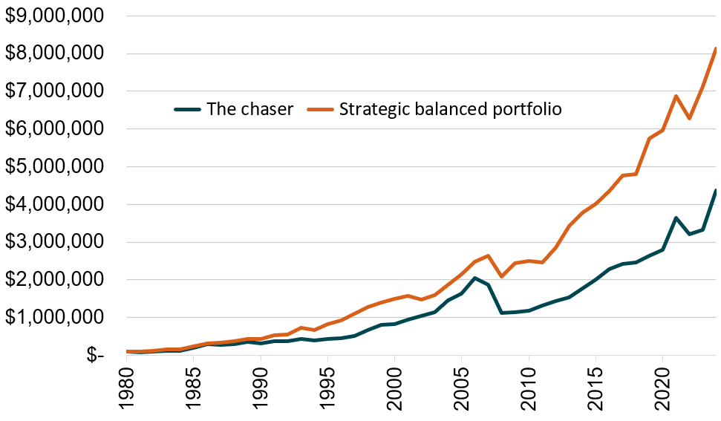
Staying invested would have kept you ahead Over the long term, staying invested would have given you better returns compared to ‘the chaser’ who is clouded by hype and reacts to the latest news
Value of $100,000 invested since December 1980
Balanced investor –
staying fully invested
$ 8,121,486
$ 4,376,551
The chaser moves in and out of the market by investing in last year’s best performing asset class
Past performance is not a reliable indicator of future performance. Source: Calculations by MLC Asset Management Services Limited. Data as at 31 December 2024, based on market index data. All Ordinaries Total Return Index, MSCI World Gross Index ($A), Bloomberg AusBond Composite Bond Index (ASAM) (Commonwealth Bank Bond Accumulation Index prior to September 1989), S&P/ASX200 Property Total Return Index (Listed Property Trust Accumulation Index prior to July 2000), Bloomberg AusBond Bank Bill Index (RBA 13 Week Treasury Notes prior to April 1987). Chaser assumes 100% investment in the highest performing asset class from the previous year. Balanced investor asset allocation: Australian shares:37%, global shares: 24%, Australian bonds: 31%, listed property securities: 8%, cash 0%. Income and dividends reinvested.

Slide 14
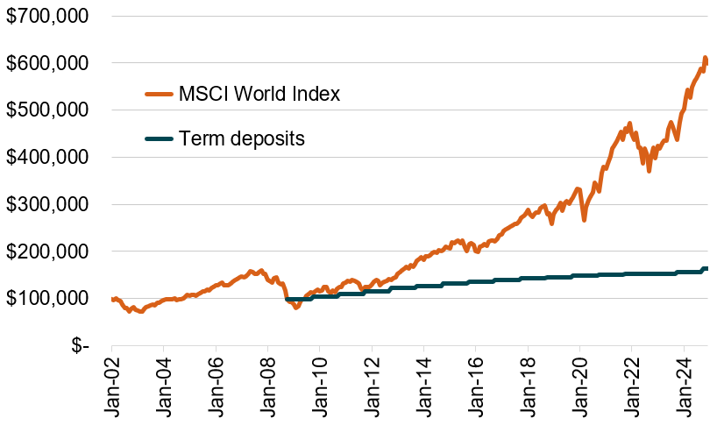
Comparison of returns from global shares and term deposits since the GFC
Value of $100,000 invested since January 2002
$599,898
Lehman collapse
$164,078
If you’d remained invested in global shares after Lehman Brothers collapsed you’d have $600k compared to $164k if you moved your money to a term deposit.
Past performance is not a reliable indicator of future performance.
Source: MLC Asset Management Services Limited, data updated to 31 December 2024. MSCI World Index ($A).
Term deposits: 1 year bank’s term deposit ($100,000) – Reserve Bank of Australia.

Slide 15
Impact of world events on investment markets
Value of $10,000 invested for 74 years
The dollar value 74 years later is shown at the end of the graph (at 30 June 2024) with the average annual return in brackets.
The graph shows the value of an investment of $10,000 in the main investment markets, since 30 June 1950.
The performance returns in this communication are investment market returns and are therefore reported before deducting management fees and taxes.
Collapse of Soviet Union
Dec 1991
9/11 Terror Attacks
Sep 2001
Sub-Prime Mortgage Crisis and GFC
Dec 2007
Donald Trump wins US Presidential election
Nov 2016
Astronauts land on the moon
Jul 1969
Iranian Revolution
Jan 1979
High inflation
2022
Share markets crash worldwide
Oct 1987
COVID crash
Mar 2020
Cuban
Missile Crisis
Oct 1962
OPEC Oil Crisis
Oct 1973
$31,330,435 (11.5%pa)
$27,037,309 (11.3%pa)
$1,168,720 (6.7%pa)
DNA discovered
May 1953
$633,542 (5.8%pa)
$428,133 (5.2%pa)
Past performance is not a reliable indicator of future performance.
Source: Calculated by MLC Asset Management Services Limited based on investment market data (including reinvestment of income) from Global Financial Data, Inc. and FactSet. Returns and values for global fixed income and global shares are not hedged.

Slide 16
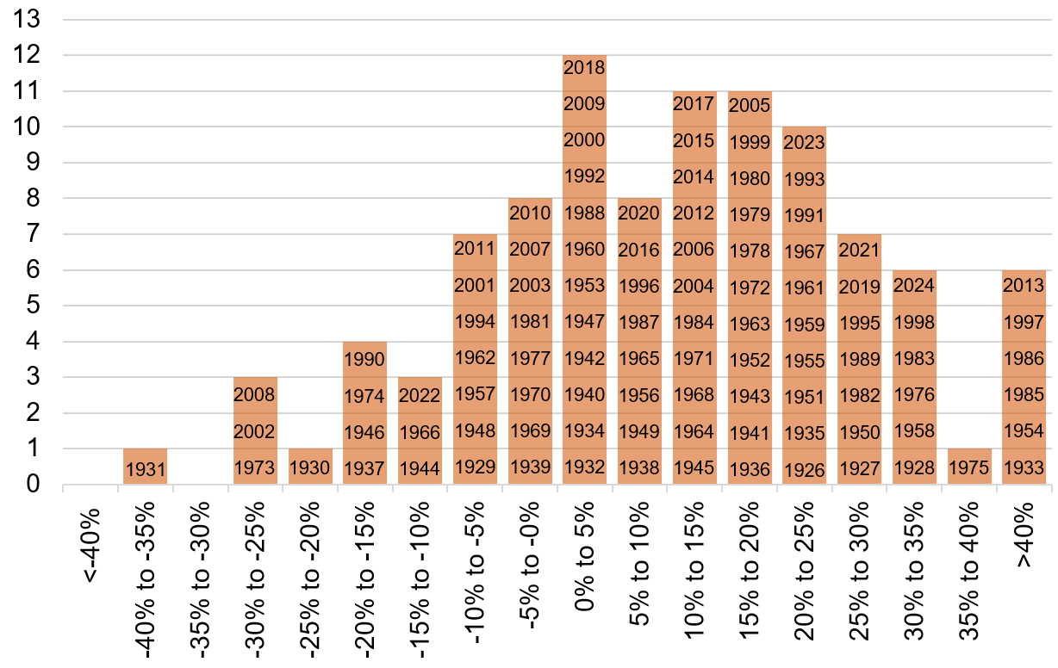
History of returns for global shares
Number of years annual returns occurred within a range
Past performance is not a reliable indicator of future performance.
Source: Calculated by MLC Asset Management Services Limited using data provided by Global Financial Data, Inc. and FactSet.
Returns are for the year ended 31 December.

Slide 17
Thank you

