Slide 1
This material is not for circulation to retail investors.
MLC Index Plus portfolios – changes to the G-REITs strategy
August 2018

Slide 2
Important information
This information is provided by MLC Investments Limited (ABN 30 002 641 661 AFSL 230705) as Responsible Entity and NULIS Nominees (Australia) Limited (ABN 80 008 515 633, AFSL 236465) as trustee of the MLC MasterKey and Fundamentals Super and Pension and MLC MasterKey Business Super products which are a part of the MLC Super Fund (ABN 70 732 426 024 (together “MLC” or “we”), all members of the National Australia Bank Limited (ABN 12 004 044 4397, AFSL 230 686) group of companies, 105–153 Miller Street, North Sydney 2060. An investment in any product offered by a member company of the National Australia Bank group of companies does not represent a deposit with or a liability of the National Australia Bank Limited (ABN 12 004 044 937) or its subsidiaries. NAB does not guarantee or otherwise accept any liability in respect of any financial product referred to in this presentation.
This presentation has been prepared for licensed financial advisers only. This document must not be distributed to “retail clients” (as defined in the Corporations Act 2001 (Cth)) or any other persons. This information is directed to and prepared for Australian residents only.
This information may constitute general advice. It has been prepared without taking account of an investor’s objectives, financial situation or needs and because of that an investor should, before acting on the advice, consider the appropriateness of the advice having regard to their personal objectives, financial situation and needs.
Investors should obtain a Product Disclosure Statement or other disclosure document relating to any financial product which is issued by MLC, and consider it before making any decision about whether to acquire or continue to hold the product. A copy of the Product Disclosure Statement or other disclosure document is available upon request by phoning the MLC call centre on 132 652 or on our website at mlc.com.au.
Past performance is not a reliable indicator of future performance. The value of an investment may rise or fall with the changes in the market.
Any opinions expressed in this presentation constitute our judgement at the time of issue and are subject to change. We believe that the information contained in this presentation is correct and that any estimates, opinions, conclusions or recommendations are reasonably held or made at the time of compilation. However, no warranty is made as to their accuracy or reliability (which may change without notice) or other information contained in this presentation.
Any projection or other forward looking statement (‘Projection’) in this document is provided for information purposes only. No representation is made as to the accuracy or reasonableness of any such Projection or that it will be met. Actual events may vary materially.
MLC relies on third parties to provide certain information and are not responsible for its accuracy. MLC is not liable for any loss arising from any person relying on information provided by third parties.
While MLC has taken all reasonable care in producing this communication, subsequent changes in circumstances may occur and impact on its accuracy.
The investment managers are current as at the date this communication was prepared. Investment managers are regularly reviewed and may be appointed or removed at any time without prior notice to you.
The following funds are affected by the changes to the G-REITs strategy. These funds appear on MLC’s platforms, in addition to a number of external platforms:
MLC Index Plus Conservative Growth Portfolio MLC Index Plus Balanced Portfolio MLC Index Plus Growth Portfolio

Slide 3
What’s changed?
In MLC Index Plus the passive global real estate investment trust (G-REIT) strategy has been moved to a quantitative, enhanced index approach:
we've replaced Vanguard’s passive strategy with Redpoint‘s quantitative, enhanced index approach, and
changed the benchmark to the FTSE/EPRA NAREIT Developed Index (AUD hedged), which we believe is more representative of G-REITs.
How may clients benefit?
Slightly improved return potential for our Index Plus portfolios with no increase in fees.

Slide 4
Why we’re making these changes
We actively manage our portfolios and work constantly to improve them.
We believe we can slightly improve the return potential of our Index Plus portfolios by replacing the passive G-REITs strategy with an enhanced index one that aims to outperform the G-REITs index.
The Index Plus portfolios were introduced in 2011 and now have sufficient FUM for us to negotiate a separate manager mandate with no increase in fees. The move to an enhanced index approach will provide the portfolios with a higher expected return potential.
Investing in a mandate rather than via an external Vanguard fund provides us with more control.
We’ve been able to introduce our preferred and more representative G-REITs benchmark, the FTSE/EPRA NAREIT Developed Index (AUD hedged). Vanguard’s benchmark is the FTSE/EPRA NAREIT Developed ex Australian Rental Index (AUD hedged) which is a narrower benchmark than Redpoint’s.
Redpoint systematically analyses companies using quantitative data techniques to outperform the G-REITs index.
The manager has a low risk approach, relative to the market.
Redpoint will manage the currency hedging overlay program for the G-REITs strategy.

Slide 5
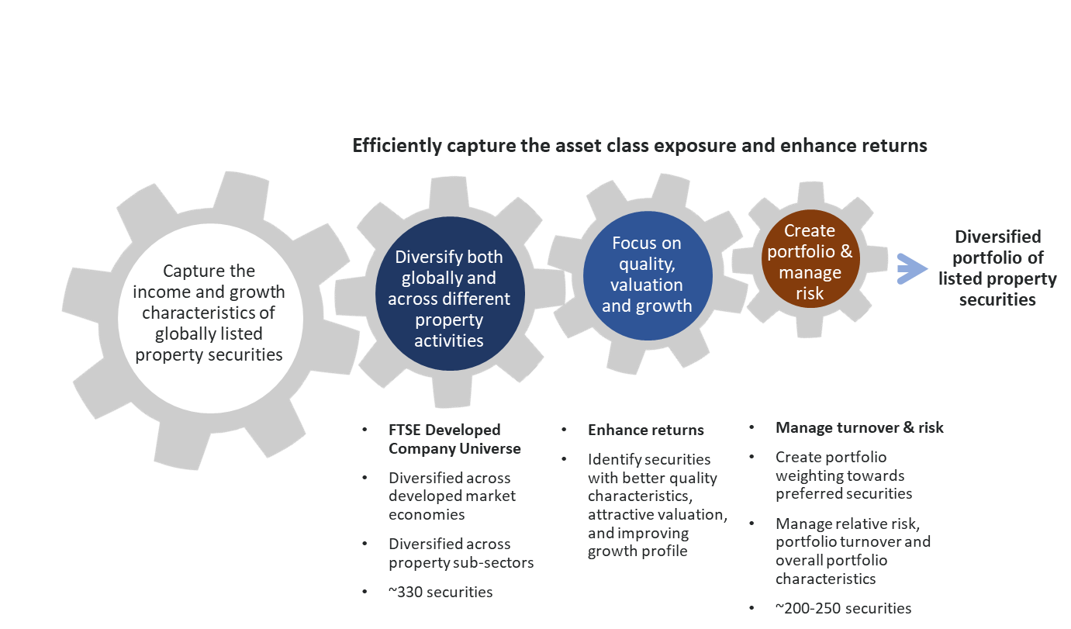
Who is the manager?
Redpoint manages more than $10.3 billion in assets (at 30/06/18).
Redpoint is a boutique partner of NAB Asset Management Services Limited.
Redpoint has managed global and Australian shares in the Index Plus portfolios since 2014. These strategies were initially passively managed by Redpoint and we’ve moved them to enhanced index in recent years.
While G-REITs is a new strategy for Redpoint, they’ll be using the same low ‘active’ risk, higher return-seeking capability they currently use in global and Australian shares.
Redpoint’s investment approach is dynamic, applying a range of strategies to enhance returns by taking small positions away from the benchmark.
Redpoint’s low turnover, low cost approach helps reduce the impact of transaction costs and taxation.
Redpoint will manage the currency hedging for the G-REITs strategy. Redpoint currently manages the currency hedge for the global shares component of the Index Plus portfolios.
Redpoint’s process uses a quantitative approach to select stocks
Source: Redpoint.

Slide 6
Are there fee implications?
There’s no impact on fees from these changes for the MLC Index Plus portfolios because they have fixed investment fees
Investment fees are available in the Fund Profile Tool on mlc.com.au and mlcinvestmenttrust.com.au
For further information regarding fees please refer to the product PDS.

Slide 7
What’s the communication plan?
Date | Audience | Communication | Location/medium
Mid August | Advisers | Strategy update presentation | Published on mlc.com.au and nabam.nab.com.au. Emailed to advisers in MLC News, NAB FP News Wrap and ENGAGE
Late August | Advisers & clients | Commentaries | Commentaries in the Fund Profile Tool will include an overview of changes reflected in the asset allocations dated 31 July
Late October | Advisers | Quarterly investment update (performance pack) | Quarterly performance pack will include an overview of changes. Emailed to advisers in MLC News, NAB FP News Wrap and Engage, and published on mlc.com.au

