Slide 1
This material is not for circulation to retail investors.
Manager changes in MLC’s fixed income strategies
September 2018

Slide 2
Important information
This information is provided by MLC Investments Limited (ABN 30 002 641 661 AFSL 230705) as Responsible Entity and NULIS Nominees (Australia) Limited (ABN 80 008 515 633, AFSL 236465) as trustee of the MLC MasterKey and Fundamentals Super and Pension and MLC MasterKey Business Super products which are a part of the MLC Super Fund (ABN 70 732 426 024 (together “MLC” or “we”), all members of the National Australia Bank Limited (ABN 12 004 044 4397, AFSL 230 686) (NAB) group of companies, 105–153 Miller Street, North Sydney 2060. An investment in any product offered by a member company of the National Australia Bank group of companies does not represent a deposit with or a liability of the National Australia Bank Limited (ABN 12 004 044 937) or its subsidiaries. NAB does not guarantee or otherwise accept any liability in respect of any financial product referred to in this presentation.
This presentation has been prepared for licensed financial advisers only. This document must not be distributed to “retail clients” (as defined in the Corporations Act 2001 (Cth)) or any other persons. This information is directed to and prepared for Australian residents only.
This information may constitute general advice. It has been prepared without taking account of an investor’s objectives, financial situation or needs and because of that an investor should, before acting on the advice, consider the appropriateness of the advice having regard to their personal objectives, financial situation and needs. Investors should obtain a Product Disclosure Statement or other disclosure document relating to any financial product which is issued by MLC, and consider it before making any decision about whether to acquire or continue to hold the product. A copy of the Product Disclosure Statement or other disclosure document is available upon request by phoning the MLC call centre on 132 652 or on our website at mlc.com.au.
Past performance is not a reliable indicator of future performance. The value of an investment may rise or fall with the changes in the market. Any projection or other forward looking statement (‘Projection’) in this document is provided for information purposes only. No representation is made as to the accuracy or reasonableness of any such Projection or that it will be met. Actual events may vary materially.
Any opinions expressed in this presentation constitute our judgement at the time of issue and are subject to change. We believe that the information contained in this presentation is correct and that any estimates, opinions, conclusions or recommendations are reasonably held or made at the time of compilation. However, no warranty is made as to their accuracy or reliability (which may change without notice) or other information contained in this presentation.
MLC relies on third parties to provide certain information and are not responsible for its accuracy. MLC is not liable for any loss arising from any person relying on information provided by third parties. While MLC has taken all reasonable care in producing this communication, subsequent changes in circumstances may occur and impact on its accuracy. The investment managers are current as at the date this communication was prepared. Investment managers are regularly reviewed and may be appointed or removed at any time without prior notice to you.
The following funds are affected by the changes to the fixed income strategy. These funds appear on MLC’s platforms, in addition to a number of external platforms:
MLC Wholesale Horizon 1 Bond Portfolio MLC Horizon 1 Bond Portfolio MySuper
MLC Wholesale Horizon 2 Income Portfolio MLC Horizon 2 Capital Stable Portfolio MLC Horizon 2 Income Portfolio
MLC Wholesale Horizon 3 Conservative Growth Portfolio MLC Horizon 3 Conservative Growth Portfolio MLC Wholesale Index Plus Conservative Growth Portfolio MLC Index Plus Conservative Growth Portfolio
MLC Wholesale Horizon 4 Balanced Portfolio MLC Horizon 4 Balanced Portfolio MLC Wholesale Index Plus Balanced Portfolio MLC Index Plus Balanced Portfolio
MLC Wholesale Horizon 5 Growth Portfolio MLC Horizon 5 Growth Portfolio MLC Wholesale Index Plus Growth Portfolio MLC Index Plus Growth Portfolio
MLC Wholesale Diversified Debt Fund MLC Diversified Debt Fund

Slide 3
What’s changed?
We’ve replaced Goldman Sachs Asset Management (GSAM), one of our global government bonds managers since 2010, with existing manager Insight Investment Management (Global) Limited (Insight). Insight has been one of our global absolute return bonds managers since 2015. We’ve now extended our relationship to include the management of global government bonds.
We’ve removed Franklin Templeton Investments (Franklin Templeton), one of our global multi-sector bonds managers since 2010. We’ve reallocated the assets to Amundi, an existing global multi-sector bonds manager.
How may clients benefit?
We expect to deliver improved and more stable returns with a modest reduction in risk relative to the benchmark. We have greater conviction in the new mix of managers to deliver to the portfolios’ objectives. There is no increase in fee.

Slide 4
Which funds are affected?
MLC Diversified Debt Fund
MLC Index Plus portfolios
MLC Horizon portfolios 1 to 5, and
MySuper.

Slide 5
Why we’re making these changes
We actively manage our portfolios and work constantly to improve them.
We believe the appointment of Insight to manage global government bonds improves the return potential of our fixed income strategies. We have strong conviction in the robustness of their investment process across the full breadth of their sources of excess returns eg country allocation and yield curve management. They have a highly skilful and stable investment team that have delivered a solid track record in managing global government bonds.
We believe the reallocation of global multi-sector bonds from Franklin Templeton to Amundi will improve the risk return profile of the fixed income strategies. Amundi has a more balanced approach to managing risks such as duration and currency compared to Franklin Templeton. Amundi’s investment style is more aligned with the objectives of our portfolios.
The managers’ allocations in our fixed income strategies are tailored across our portfolios.

Slide 6
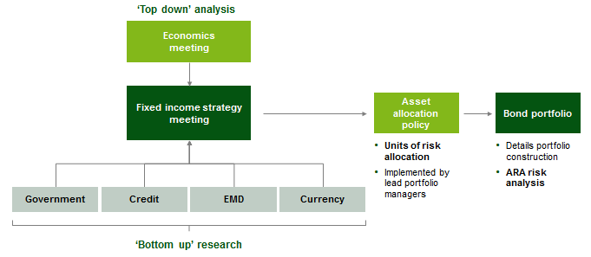
Who is the manager?
Owned by BNY Mellon Asset Management, Insight is a specialist fixed income manager.
Insight has more than A$1 trillion of assets under management (at 30/06/18).
Insight’s Fixed Income Group employs 112 investment professionals (at 30/06/18).
We appointed Insight to manage global absolute return bonds in May 2015.
We believe Insight’s strengths include robust portfolio construction and risk management capabilities executed by high quality and very experienced investment professionals responsible for the key investment decisions across interest rates, foreign exchange, government bonds and credit. Investment strategy is formulated at the investment committee, based on an assessment of strategic, tactical and technical factors.
While the majority of the assets will comprise developed market government bonds, a limited exposure to liquid emerging market local currency government bonds is permitted (up to 15%).
Insight’s investment process
Source: Insight.
Source: Insight.

Slide 7
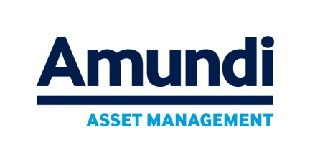
Who is the manager?
Amundi is a specialist fixed income manager.
Amundi has more than A$2,318 billion of assets under management (at 30/06/18).
Amundi’s Global Fixed Income Team employs 71 investment professionals* (at 30/06/18).
We appointed Amundi to manage global multi-sector bonds in 2010.
We believe Amundi’s distinctive investment approach complements our other multi-sector global bond manager.
Amundi’s robust investment process combines long-term strategic positions in interest rates, foreign exchange and credit with tactical choices that exploit shorter-term investment opportunities. This approach has been particularly effective in volatile markets.
Three step process reconciles fundamentals with market
Source: Amundi.
*71 Investment professionals comprising: 19 Portfolio Managers, 45 Credit Analysts, 7 Quantitative Analysts

Slide 8
Recap on MLC’s active approach to managing fixed income
Fully active approach
Adds to returns and reduces risk. Indices are generally weighted by issuers so the most indebted countries have the most weighting in indices eg Japan which has near-zero interest rates would have a high weighting in a passive strategy whereas we have a very low exposure to Japan in our strategies.
Very well diversified
Across fixed income sectors, managers and securities - reducing the risk of big positions going wrong, allowing greater control of risks at the sector level.
Flexibly managed
We manage interest rate and credit risk when we believe it’s needed.

Slide 9
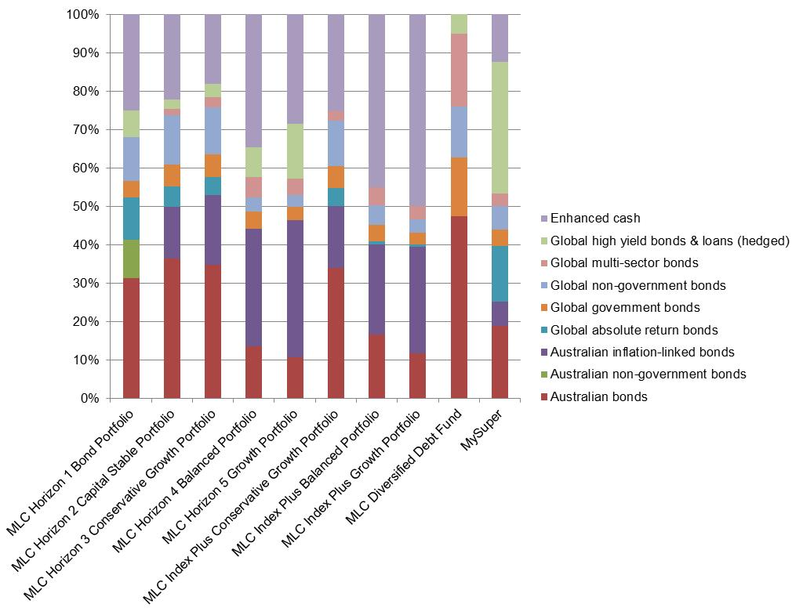
We tailor our fixed income strategies to our portfolios
Our portfolios are well diversified, accessing multiple categories of fixed income sectors, both in Australia and globally.
Source: NAB Asset Management Services Limited as at 31 August 2018 - applies to MLC MasterKey Super and Pension products.

Slide 10
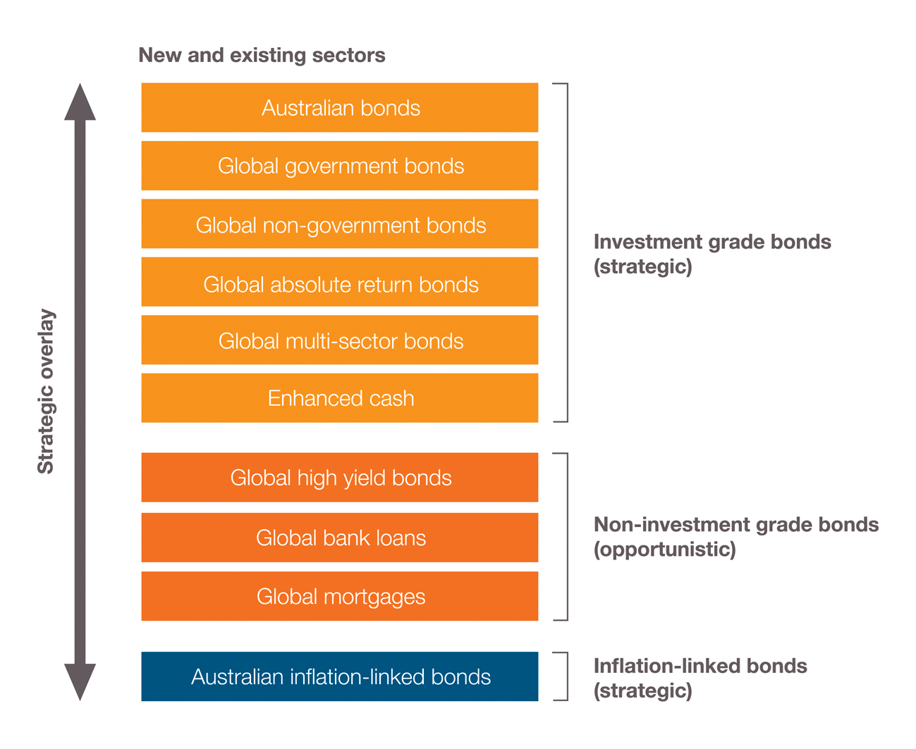
MLC’s fixed income strategies - more than meets the eye
Notes:
10

Slide 11
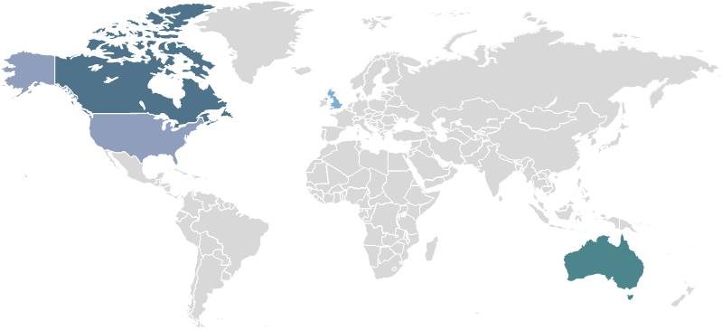
Your specialist fixed income managers
Global bonds
Manager | Assets | Location
Amundi | Global multi-sector bonds | London
BNP (formerly FFTW) | Global absolute return bonds | USA and UK
Insight | Global absolute return bonds, global government bonds | London, UK
Loomis Sayles | Global investment grade non-government bonds; global high yield bonds & loans | Boston, USA
Muzinich | Global high yield bonds & loans | New York, USA
PIMCO | Global multi-sector bonds | Newport Beach, California, USA
Shenkman Capital | Global high yield bonds & loans | New York, USA
Wellington Management | Global investment grade non-government bonds | Boston, USA
Australian bonds
Manager | Assets | Location
Antares Fixed Income | Australian bonds; Australian non-government bonds; Australian inflation-linked bonds | Sydney, Australia
UBS | Australian bonds | Sydney, Australia
Cash
Manager | Asset | Location
Antares Fixed Income | Enhanced cash | Sydney, Australia
Source NAB Asset Management Services Limited as at September 2018. Managers are subject to change, managers vary per MLC multi-asset portfolio.
11

Slide 12
Are there fee implications?
There’s no impact to the investment management fees for the following funds as a result of these changes:
MLC Diversified Debt Fund
MLC Index Plus portfolios
MLC Horizon 1 to 5 portfolios, and
MySuper.
Investment fees are available in the Fund Profile Tool on mlc.com.au and mlcinvestmenttrust.com.au
For further information regarding fees please refer to the product PDS.

Slide 13
What’s the communication plan?
Date | Audience | Communication | Location/medium
Late September | Advisers | Strategy update presentation | Published on mlc.com.au and nabam.nab.com.au. Emailed to advisers in MLC News, NAB FP News Wrap and Engage
Late October | Advisers & clients | Commentaries | Commentaries in the Fund Profile Tool will include an overview of changes reflected in the asset allocations dated 30 September
Late October | Advisers | Quarterly investment update (performance pack) | Quarterly performance pack will include an overview of changes. Emailed to advisers in MLC News, NAB FP News Wrap and Engage, and published on mlc.com.au

