Slide 1
Manager change in MLC’s fixed income strategies
August 2019
This material is not for circulation to retail investors.

Slide 2
Important information
This information is provided by MLC Investments Limited (ABN 30 002 641 661 AFSL 230705) (“MLCI”) as Responsible Entity and the operator of MLC MasterKey Investment Service Fundamentals and NULIS Nominees (Australia) Limited (ABN 80 008 515 633, AFSL 236465) as trustee of the MLC MasterKey and Fundamentals Super and Pension and MLC MasterKey Business Super products which are a part of the MLC Super Fund (ABN 70 732 426 024 (together “MLC” or “we”). We are all members of the NAB group of companies comprised of National Australia Bank Limited (ABN 12 004 044 4397, AFSL 230686) (“NAB”), its related companies, associated entities and any officer, employee, agent, adviser or contractor (“NAB Group”). An investment in any product offered by a member company of the National Australia Bank group of companies does not represent a deposit with or a liability of the National Australia Bank Limited (ABN 12 004 044 937) or its subsidiaries. NAB does not guarantee or otherwise accept any liability in respect of any financial product referred to in this presentation.
This presentation has been prepared for licensed financial advisers only. This document must not be distributed to “retail clients” (as defined in the Corporations Act 2001 (Cth)) or any other persons. This information is directed to and prepared for Australian residents only.
Some information contained in this presentation may constitute general advice. It has been prepared without taking account of an investor’s objectives, financial situation or needs and because of that an investor should, before acting on the advice, consider the appropriateness of the advice having regard to their personal objectives, financial situation and needs. Investors should obtain a Product Disclosure Statement or other disclosure document relating to any financial product which is issued by MLC, and consider it before making any decision about whether to acquire or continue to hold the product. A copy of the Product Disclosure Statement or other disclosure document is available upon request by phoning the MLC call centre on 132 652 or on our website at mlc.com.au.
The value of an investment may rise or fall with the changes in the market. Any projection or other forward looking statement (‘Projection’) in this document is provided for information purposes only. Whilst reasonably formed, no representation is made as to the accuracy of any such Projection or that it will be met. Actual events may vary materially.
The information in this communication is indicative and prepared for information purposes only and does not purport to contain all matters relevant to any particular investment or financial instrument. Any opinions expressed in this communication constitute our judgement at the time of issue. We believe that the information contained in this communication is correct and that any estimates, opinions, conclusions or recommendations are reasonably held or made at the time of compilation. However, no warranty is made as to their accuracy or reliability. The information in this communication is subject to change without notice, and we shall not be under any duty to update or correct it. All statements as to future matters are not guaranteed to be accurate and any statements as to past performance do not represent future performance. We may rely on third parties to provide certain information. We are not responsible for its accuracy or liable for any loss arising from person relying on information provided by third parties. Subject to any terms implied by law and which cannot be excluded, we shall not be liable for any errors, omissions, defects or misrepresentations in this communication (including by reasons of negligence, negligent misstatement or otherwise) or for any loss or damage (whether direct or indirect) suffered by persons who use or rely on the communication.
While MLC has taken all reasonable care in producing this communication, subsequent changes in circumstances may occur and impact on its accuracy. The investment managers are current as at the date this communication was prepared. Investment managers are regularly reviewed and may be appointed or removed at any time without prior notice to you.
The following funds are affected by the changes to the fixed income strategy. These funds appear on MLC’s platforms, in addition to a number of external platforms:
MLC Wholesale Horizon 1 Bond Portfolio MLC Horizon 1 Bond Portfolio MySuper
MLC Wholesale Horizon 2 Income Portfolio MLC Horizon 2 Capital Stable Portfolio MLC Horizon 2 Income Portfolio
MLC Wholesale Horizon 3 Conservative Growth Portfolio MLC Horizon 3 Conservative Growth Portfolio
MLC Wholesale Horizon 4 Balanced Portfolio MLC Horizon 4 Balanced Portfolio
MLC Wholesale Horizon 5 Growth Portfolio MLC Horizon 5 Growth Portfolio
MLC Wholesale Diversified Debt Fund MLC Diversified Debt Fund

Slide 3
What’s changed?
We’ve appointed Oaktree Capital Management, L.P. (Oaktree) to manage part of our global high yield bonds and loans allocation. This will be funded by a reduced allocation to Shenkman Capital Management, Inc. (Shenkman Capital).
Oaktree was previously our United States high yield loans manager between 2005 to 2017. We removed Oaktree in 2017 because we were looking for a broader global strategy.
Oaktree has now developed a global, multi-sector strategy which will complement our existing high yield managers. Oaktree’s capabilities provides us with greater scope to add value and manage credit risks.
Which funds are affected?
MLC Diversified Debt Fund
MLC Horizon portfolios 1 to 5, and
MySuper.

Slide 4
Why we’re making these changes
We actively manage our portfolios and evolve them as the investment environment changes and opportunities arise.
Oaktree’s new portfolio gives us access to a greater diversity of investments (eg countries and securities). This will help improve the return potential of our fixed income strategies. Prior to Oaktree’s appointment, our high yield strategies were concentrated mainly in high yield loans in the United States.
Oaktree invests in high yield loans and bonds in developed markets (US and Europe) and emerging markets (Asia, Latin America, Eastern Europe). Oaktree also invests in real estate debt, convertibles and corporate structured securities.
We have strong conviction in the robustness of Oaktree’s investment style and credit selection process. Oaktree’s defensive investment philosophy provides our portfolios with downside protection. The manager has a highly skilled and stable investment team that has delivered a strong track record in managing global high yield fixed income.

Slide 5
How may clients benefit?
We expect improved return potential for our fixed income portfolios without a material change to their risk profile. This is due to greater access to high yield investments across regions and countries.
There is no increase in the investment management fees.

Slide 6
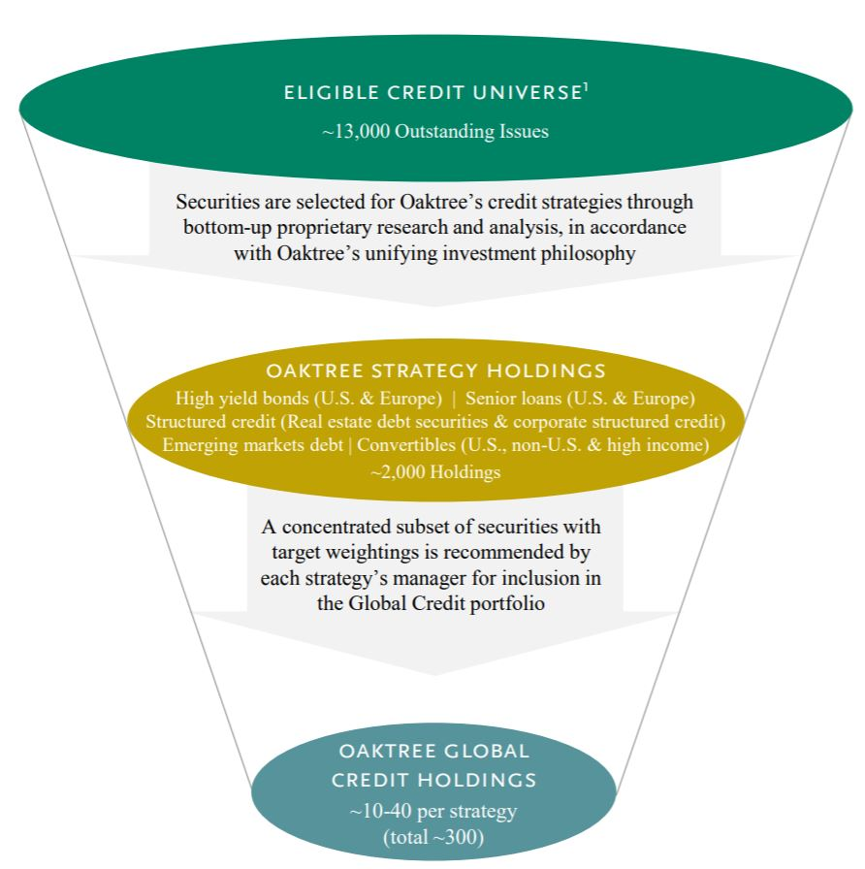
Who is Oaktree?
Oaktree is a specialist fixed income manager appointed to manage our global high yield fixed income in July 2019.
The company was formed in 1995 in Los Angeles by a group of skilled professionals who had been investing together since the mid-1980s. The manager has expertise in global high yield loans and bonds across a broad range of sectors in developed and emerging markets.
Oaktree has US$119 billion of assets under management.
Oaktree’s global credit fixed income team employs 14 investment professionals with rigorous due diligence supported by approximately 100 credit research analysts.
Oaktree has a strong performance track record of constructing well-diversified, liquid high yield loans and bonds portfolios.
When choosing securities, Oaktree adopts a defensive investment philosophy and applies a bottom-up approach, evaluating relative value and risk-adjusted return potential of the best ideas from each of its asset classes.
Information at 31 March 2019.
Oaktree’s portfolio construction process

Slide 7
Target manager allocations – global high yield fixed income strategy
Manager | MLC Diversified Debt Fund | MLC Horizon 1 Bond Portfolio | MLC Horizon 2 Capital Stable Portfolio | MLC Horizon 2 Income Portfolio | MLC Horizon 3 Conservative Growth Portfolio | MLC Horizon 4 Balanced Portfolio | MLC Horizon 5 Growth Portfolio | MySuper
 | % (change) | % (change) | % (change) | % (change) | % (change) | % (change) | % (change) | % (change)
Oaktree | 0.25 (+0.25) | 0.35 (+0.35) | 0.08 (+0.08) | 0.15 (+0.15) | 0.08 (+0.08) | 0.10 (+0.10) | 0.10 (+0.10) | 0.38 (+0.38)
Loomis Sayles | 1.73 (0.00) | 2.43 (0.00) | 0.51 (0.00) | 1.04 (0.00) | 0.51 (0.00) | 0.69 (0.00) | 0.69 (0.00) | 2.59 (0.00)
Muzinich | 1.02 (0.00) | 1.42 (0.00) | 0.31 (0.00) | 0.61 (0.00) | 0.31 (0.00) | 0.41 (0.00) | 0.41 (0.00) | 1.53 (0.00)
Shenkman Capital | 2.00 (-0.25) | 2.80 (-0.35) | 0.60 (-0.08) | 1.20 (-0.15) | 0.60 (-0.08) | 0.80 (-0.10) | 0.80 (-0.10) | 3.00 (-0.38)
Global high yield fixed income (as % of total portfolio) | 5.00 | 7.00 | 1.50 | 3.00 | 1.50 | 2.00 | 2.00 | 7.50
Notes: As at July 2019. Figures are rounded to two decimal places and based on target asset allocations.

Slide 8
Are there fee implications?
There’s no impact on fees for the following funds as a result of these changes because they have fixed investment or management fees:
MLC MasterKey Unit Trust - MLC Wholesale Horizon 1 to 5 and Diversified Debt portfolios
MLC Investment Trust - MLC Wholesale Horizon 1 to 5 and Diversified Debt portfolios, and
MySuper.
For funds that have variable investment fees, there may be marginal fee movements. However, we give you at least 30 days' notice of any material fee increase. The following funds have variable investment fees:
MLC MasterKey superannuation and pension platforms - MLC Horizon 1 to 5 and Diversified Debt portfolios.
Investment fees are available in the Fund Profile Tool on mlc.com.au and nabam.nab.com.au
For further information regarding fees please refer to the product PDS.

Slide 9
What’s the communication plan?
Date | Audience | Communication | Location/medium
Early August | Advisers | Strategy update presentation | Published on mlc.com.au and nabam.nab.com.au. Emailed to advisers in MLC News, NAB FP News Wrap and Engage
Mid August | Advisers and clients | Commentaries | Commentaries in the Fund Profile Tool will include an overview of changes reflected in the asset allocations dated 31 July 2019
Late October | Advisers | Quarterly investment update (performance pack) | Quarterly performance pack will include an overview of changes. Emailed to advisers in MLC News, NAB FP News Wrap and Engage, and published on mlc.com.au
More information
You can find up-to-date asset allocations, manager allocations, portfolio performance and investment fees for each fund at mlc.com.au/fundprofiletool and nabam.nab.com.au.

